Slide 1
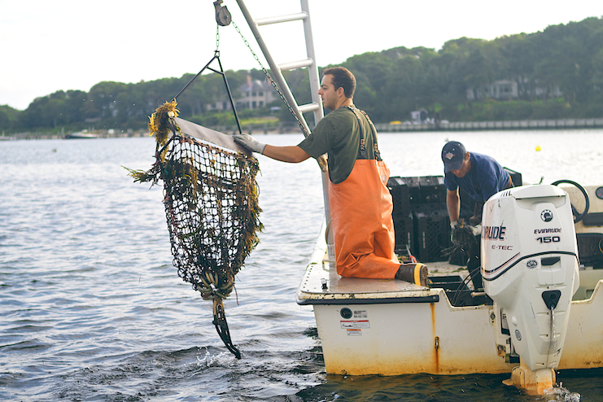
Massachusetts Clinical and Environmental Strain Types and Illness
Chris Schillaci
Division of Marine Fisheries
Massachusetts Department of fish & Game

Slide 2
ST of confirmed environmental isolates from 2014-2016
Strain Type | # Isolates
36* | 1
631* | 1
771 | 1
1185 | 6
1156 | 2
1187 | 1
1399 | 1
NF | 29
Involved in clinical illness
ST of confirmed clinical isolates from illnesses 2014-2016
Area | ST36 | ST631 | ST199 | ST670 | ST1127 | ST1156 | ST1728
Katama Bay | 16 |  | 1
WCCB | 8 | 6 |  |  | 1
ECCB | 4 |  | 1 | 1 | 1 | 1 | 1

Slide 3
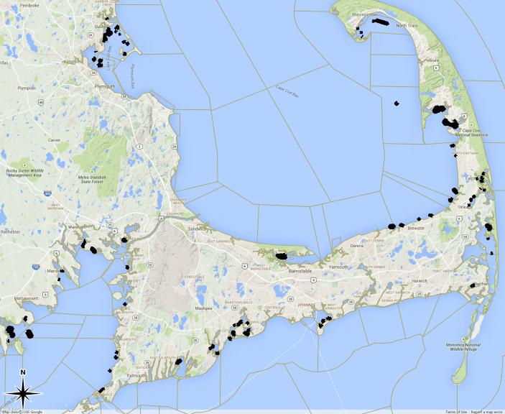
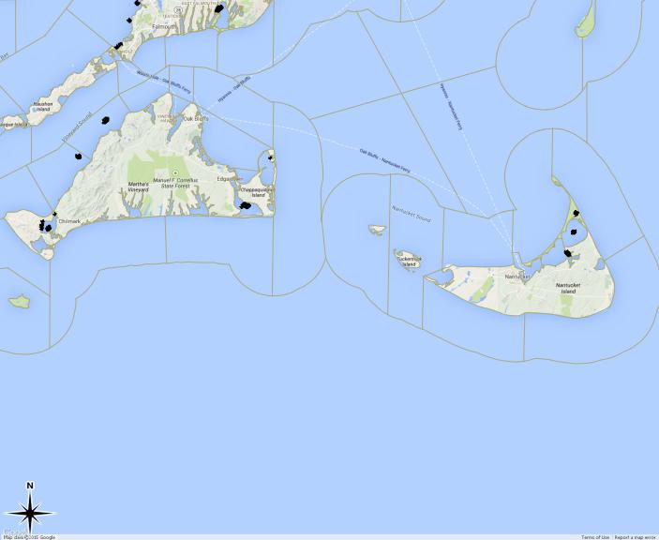
Primary Massachusetts Oyster Harvest Areas implicated in Vp. Illness %ST of Clinical Isolates
95%- ST36
~50%- ST36, 40% ST631
~25% ST36
“Sporadic”
“Outbreak”
Figure chart showing percent each Strain type has been impicated in a Vp. case Xu et al, 2015

Slide 4
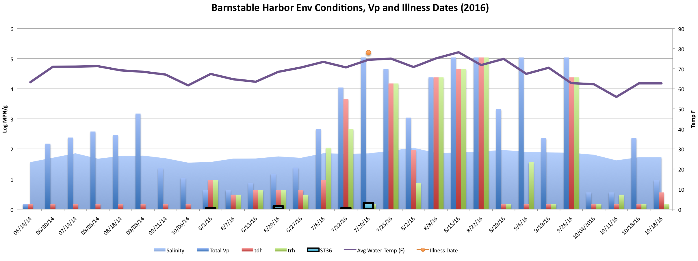
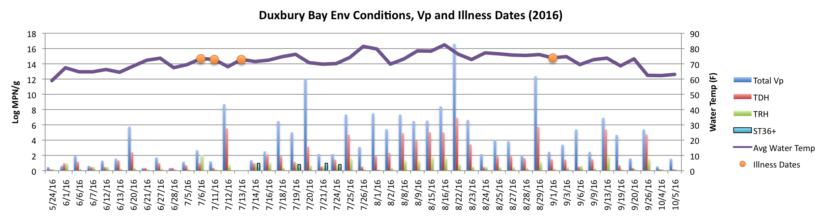

Slide 5
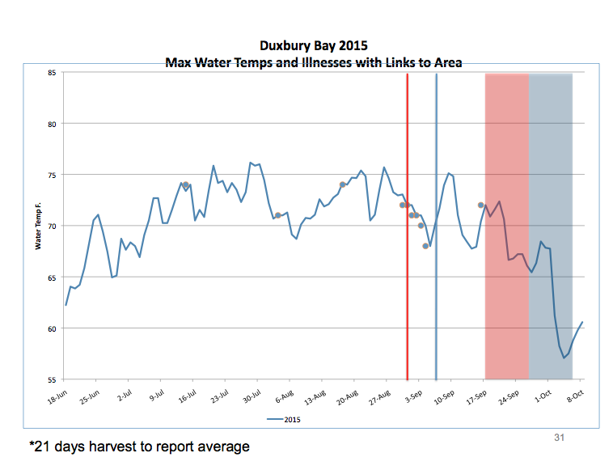

Slide 6
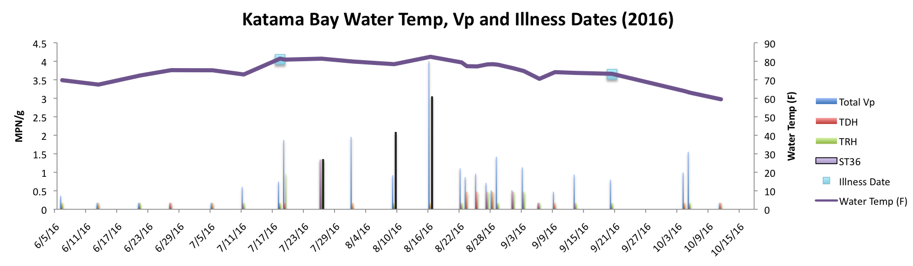
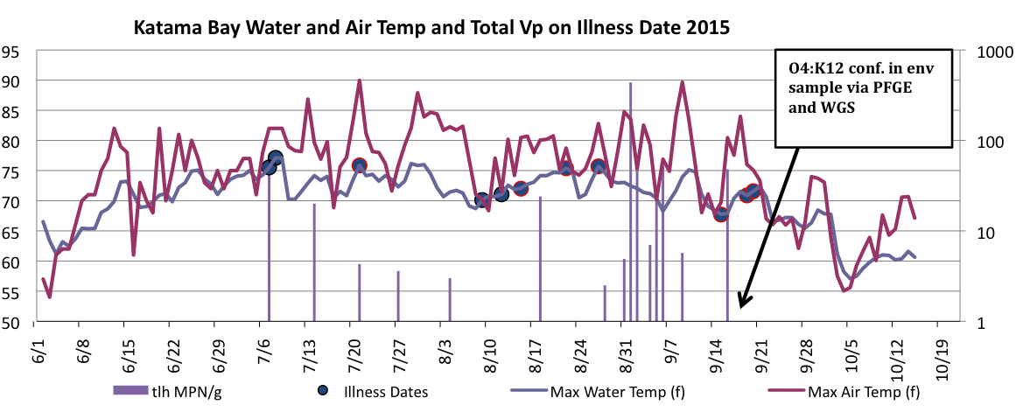

Slide 8
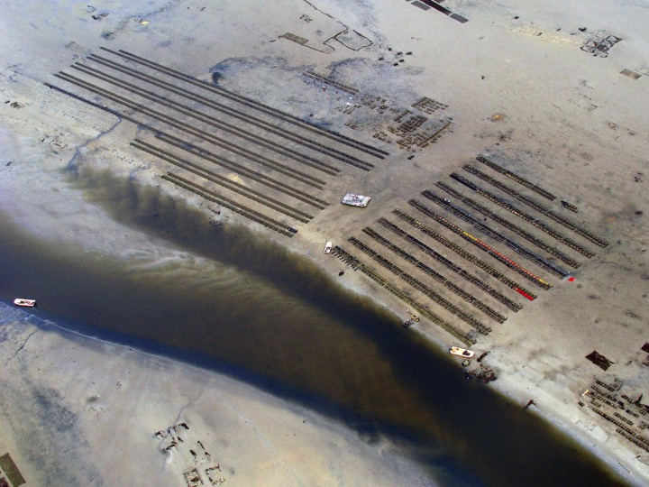
Thank You
Massachusetts Oyster Industry
Eric Hickey, Steve Rice, Scott Troppy, Johanna Vostok,
Esther Fortes, Tracy Stiles MA-DPH
Cheryl Whistler, Steve Jones, Meg Hartwick, Feng Xu, Kari Hartman UNH
Diane Murphy Cape Cod Cooperative Extension
Diane Regan, Sue Bohler Gabe Lundgren MA-DMF
Andy Depaola, Jessica Jones, John Bowers - USFDA
John Jacobs, Bob Daniels- NOAA
Kristin DeRosia-Banick, CT-DA

