Slide 1
Vibrio parahaemolyticus in Virginia

Slide 2
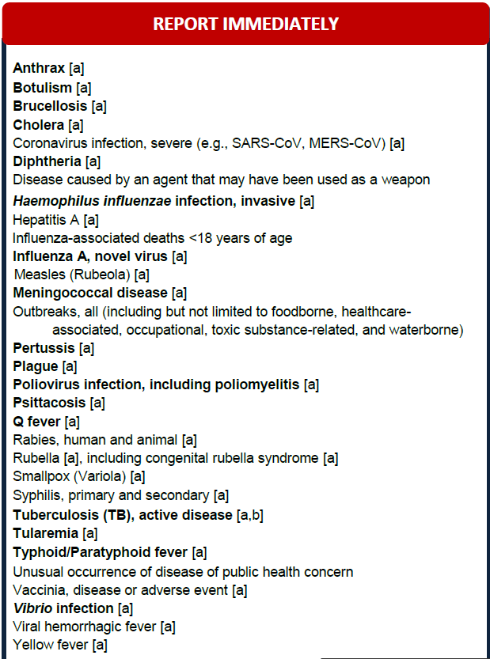
Vibriosis illness reporting
Vibriosis (all species) is a rapidly reportable condition in Virginia
Reporting is done to the local health department
Reporting may be by phone call, fax, or increasingly by electronic lab reporting
Local health departments enter the case in the VDH electronic surveillance system which is viewable by local, regional, and central office staff
Central office staff run reports twice a week to identify new cases and ensure timely transfer of information and forms

Slide 3
Vibriosis illness reporting
Isolates or specimens are required to be submitted to the state public health laboratory for any culture or CIDT positive specimens
Submission requirement was recently added (Oct. 2016), previously it was voluntary and varied by year.
Year | % Sent to Public Health Lab
2016 | 47%
2015 | 50%
2014 | 31%
2013 | 60%
2012 | 44%

Slide 4
Vibriosis illness investigation
Local health districts are the lead investigators
Public Health Nurses or Epidemiologists
Fill out the COVIS form based on medical records and interview with patient or surrogate
Completed COVIS forms are sent to the VDH central office for review and transmission to CDC

Slide 5
Vibriosis partners
Local environmental health and state Division of Shellfish Sanitation involved if there is seafood consumption
Cases with consumption at an out of state location are sent to that state for follow-up – this is typically coordinated by the Division of Shellfish Sanitation

Slide 6
Vibriosis investigation timelines
Report to Health Department
Should be within 24 hours of diagnosis
Local Health Department initiates investigation
Goal is within 24 hours of receipt of report to initiate investigation
Conduct investigation
Factors include: How long it takes to reach patient, complexity of food history (multiple exposures, etc.), whether consumption is within the same jurisdiction, speed of gathering tag information
Submit COVIS to CDC
Within 24 hours of receipt of completed form by VDH central office

