Slide 1
2017 NSSP Model Ordinance Chapter VI. Shellfish Aquaculture
Overview of New Requirements

Slide 2
Definition
Aquaculture Chapter
Requirements for the
Authority
________________________________
Definition
General Requirements
Seed Shellstock
Federal Waters
Notes:
Overview of NSSP MO requirements that will be discussed in this presentation.
During this presentation we will discuss the definition of Aquaculture, as well as, new requirements for the Authority. These requirements are divided between General Requirements, and Seed Shellstock. Another new addition to this chapter is Federal Waters, but that will not be discussed in detail in this presentation. Its also very important to recognize that an ISSC workgroup is supposed to develop a guidance document for this chapter.

Slide 3
Aquaculture Chapter
Harvester/
Dealer
Requirements
________________________________
Exceptions
General Requirements
Seed Production
Aquaculture that Attracts Birds or Mammals
Polyculture Systems
Federal Waters
Land Based Aquaculture
Notes:
Continuation of overview of the NSSP MO requirements for aquaculture…
The Harvester/Dealer requirements for Aquaculture are divided up in to seven (7) sections… Exceptions, General Requirements, Seed Production in waters classified as Prohibited or that are unclassified, AQ that attracts Birds or Mammals, Land Based Aquaculture, Polyculture Systems, and again Federal Waters.

Slide 4
NSSP MO Aquaculture Definition
Aquaculture means cultivating shellfish in controlled conditions for human consumption. Cultivation includes propagation and growing of shellfish. These activities may occur in natural or man-made water bodies. These activities include seed collection, production, and cultivation in natural water bodies when shellfish are held off the bottom such as the use of racks, bags, or cages, and when shellfish are held in man-made water bodies such as the use of tanks, ponds, or raceways. These activities do not include depuration or wet storage.
Notes:
SUMMARIZE (or read) THE DEFINITION FIRST.
Remember there was not a definition in the NSSP MO prior to 2017. The 2015 NSSP MO also included shellfish gardening in the AQ Chapter. Additional changes are bottom plant aquaculture, whether broadcast or utilizing bags, racks, or cages in subtidal conditions is now not required to be covered by this chapter.
Note… In intertidal areas if the cages, bags, etc. attract birds when the tide is out, the Authority needs to access this to determine whether they must meet these requirements.
Note… Shellfish beds with predator nets, are not typically included in this requirement. This is addressed under other sections of the MO (Control of Harvest, Growing area).

Slide 5
NSSP MO Chapter VI @.01
General
________________________________
AQ activities regulated in this section include: (1) Seed production in prohibited or unclassified waters (2) AQ structures that attract birds or mammals (3) land based AQ.
The Authority shall: (1) Approve written operational plans (2) Inspect operations at least annually (3) Inspect records (4) When AQ attracts birds or mammals, their presence should be considered for possible adverse effects on the growing area.
Notes:
AQ activities regulated in the @.01 General section include seed production in prohibited or unclassified waters, structures that attract birds or mammals and land based AQ.
There are four (4) “shall” for the Authority in this section… Approve a written operational plan, inspect operations described in @.01 at least annually, inspect records to verify permits are up-to-date and ensure that the operational plan is being implemented and the final is to access potential adverse effects birds or mammals may have on water quality when they are attracted by AQ structures.
Remember that sources of seed produced in prohibited or unclassified waters must be sanctioned by the authority. Inspections must be completed annually but there are currently no requirements that describe what this inspection should look like or cover. As a reminder, inspection records should be maintained by the authority.

Slide 6
Authority Requirements
NSSP MO Chapter VI @.02
Seed Production
The Authority shall establish the maximum seed size … in prohibited waters. In determining the maximum seed size …. require a minimum of 120 days of growing to reach market size.
Authority shall establish appropriate corrective actions for when seed exceeds the maximum seed size when it has been produced in waters classified as prohibited.
All sources of seed produced or collected in prohibited waters shall be sanctioned by the Authority.
Notes:
For seed produced in Prohibited waters, a maximum seed size for each species must be establish by the authority. When the authority determines these seed sizes, they must take in to consideration that the sizes require a minimum of 120 days for growing to reach market size. Seed that is greater in size than that established by the authority may be used if the authority has established corrective actions.
Corrective Action Intent... Under different conditions (long closures for example) seed may grow larger than established seed size. If this is allowed, some type of corrective action is necessary. Seed near market size must stay planted 120 days or more. Nothing was set on what a corrective action plan looks like. This is up to the Authority.
Again, this is for seed grown in Prohibited or unclassified waters. Remember that Authorities can establish rules that are more restrictive and some have.

Slide 7
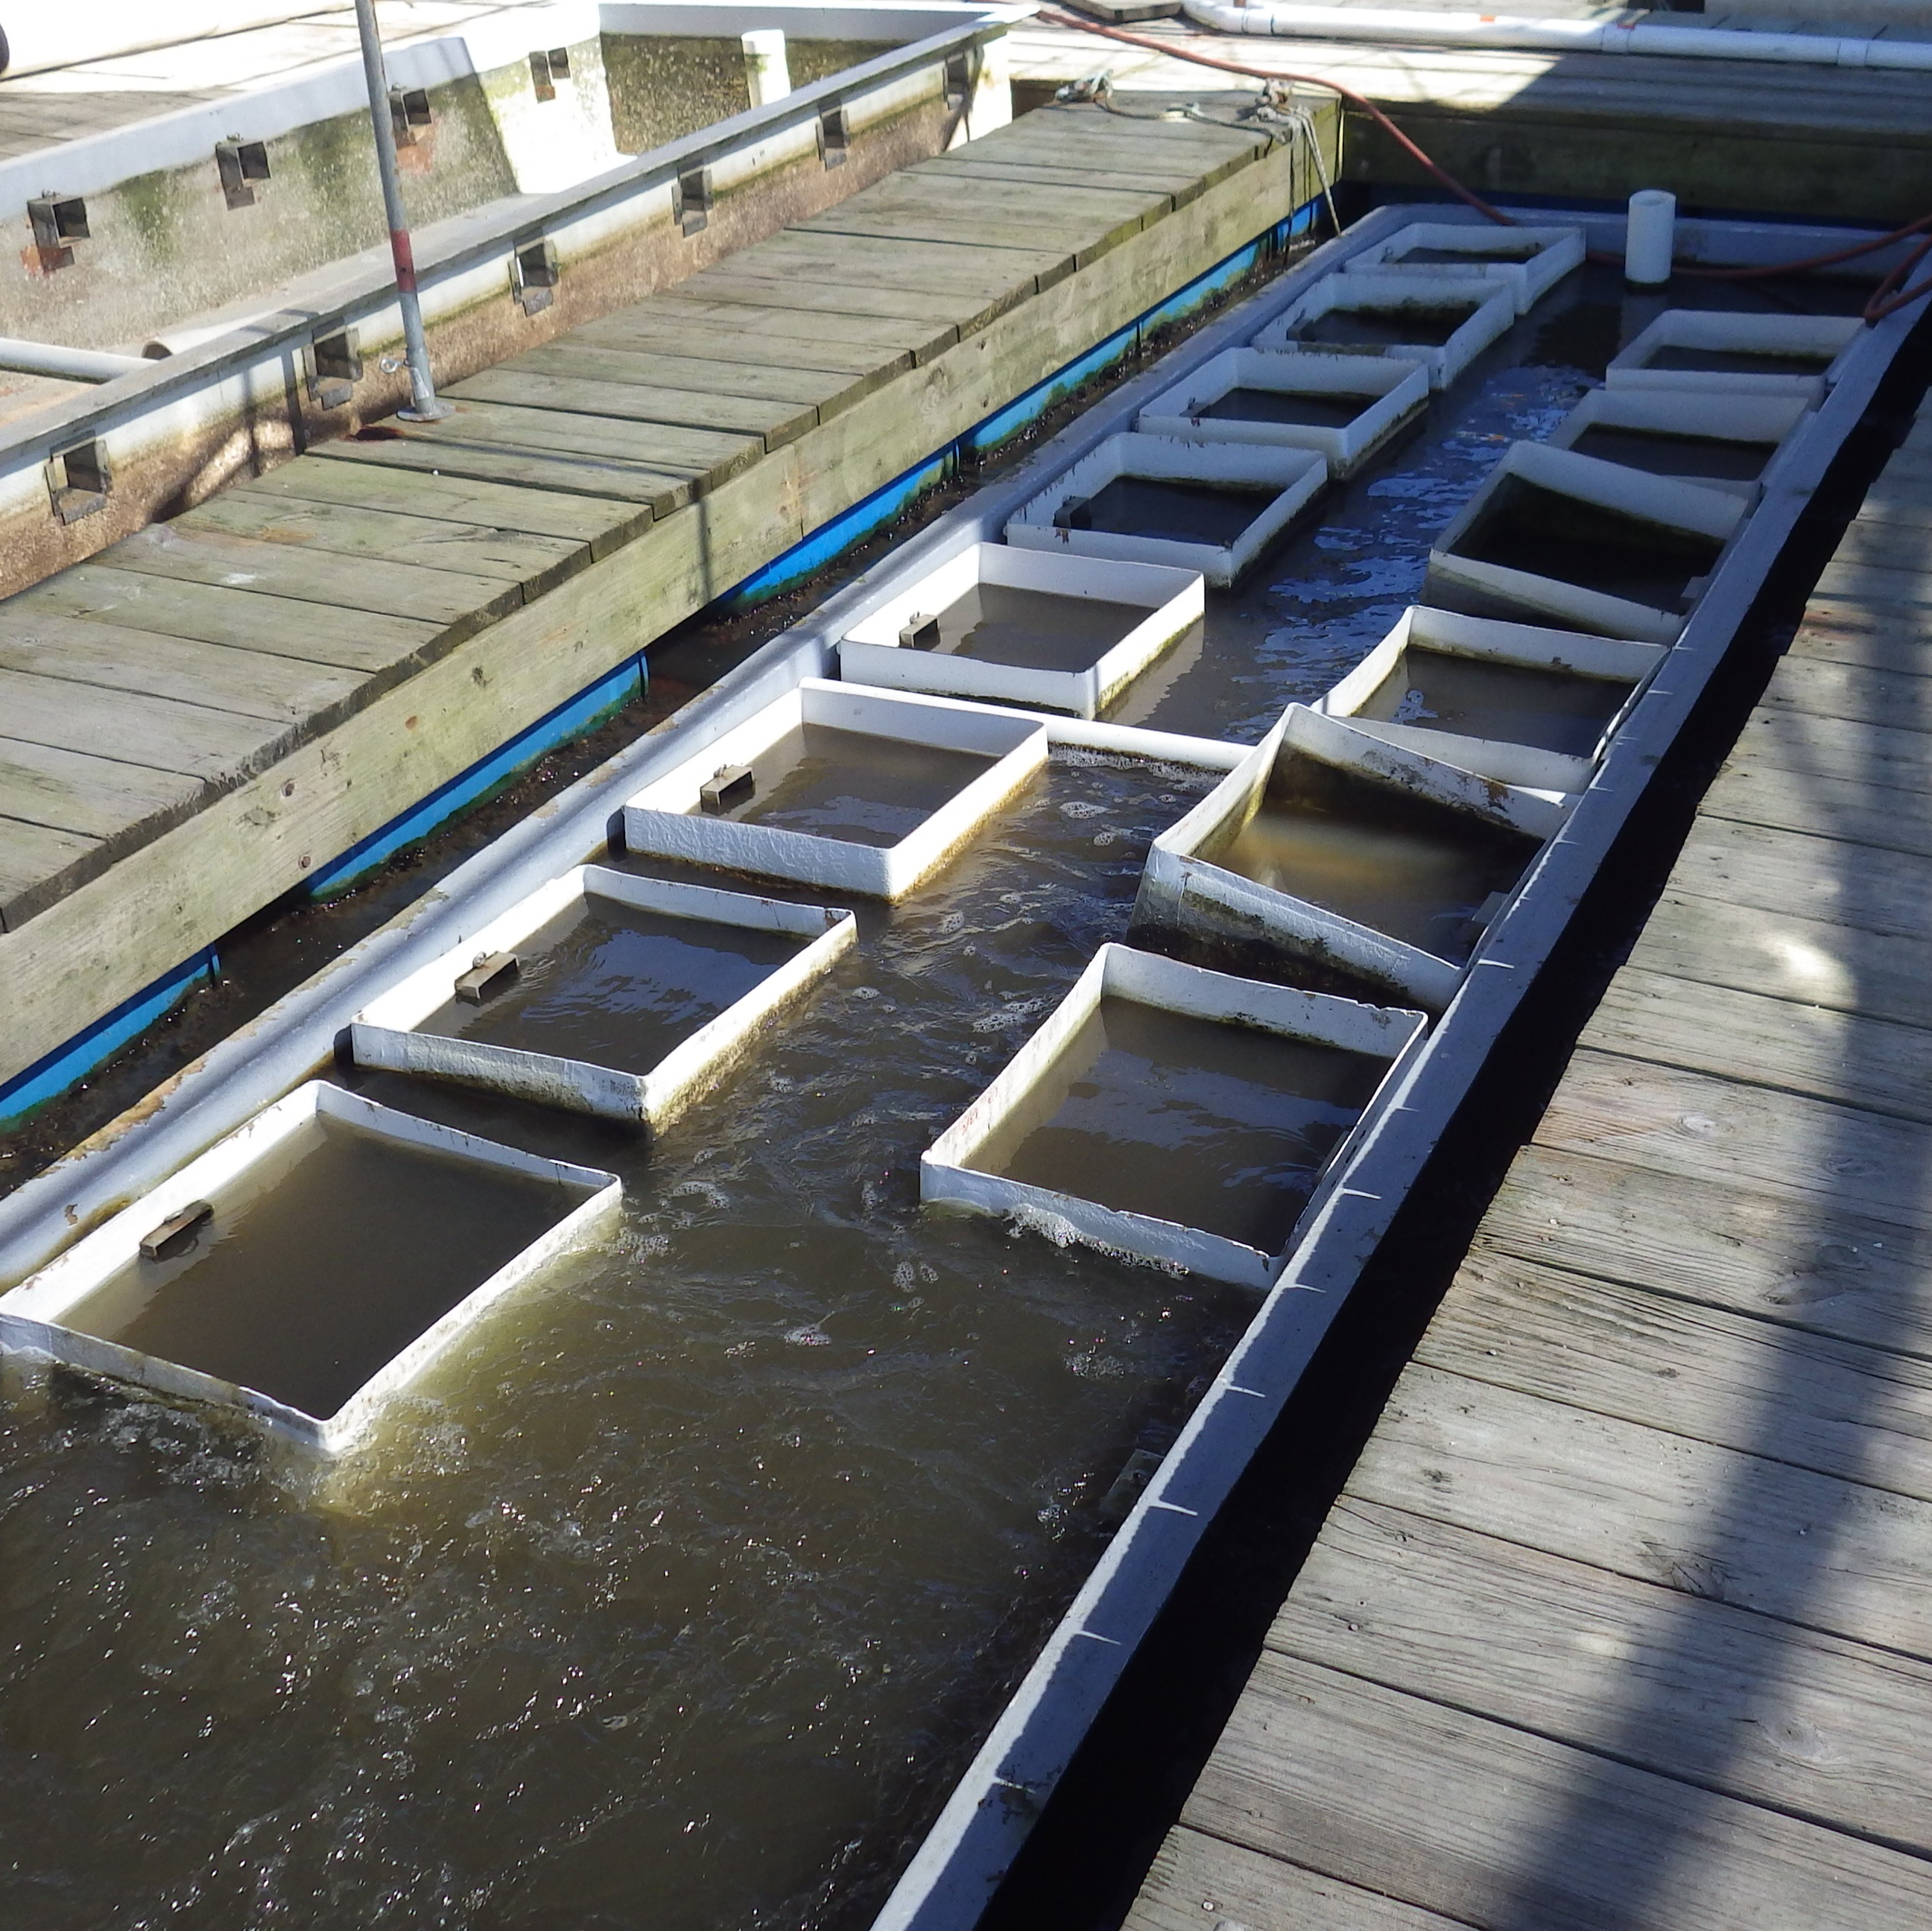
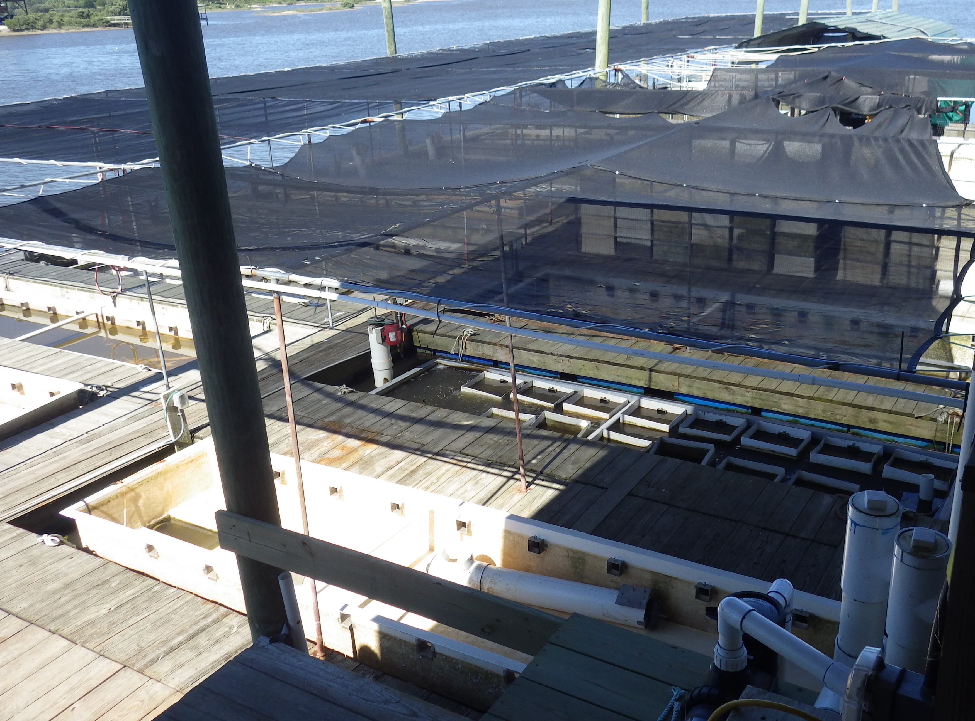
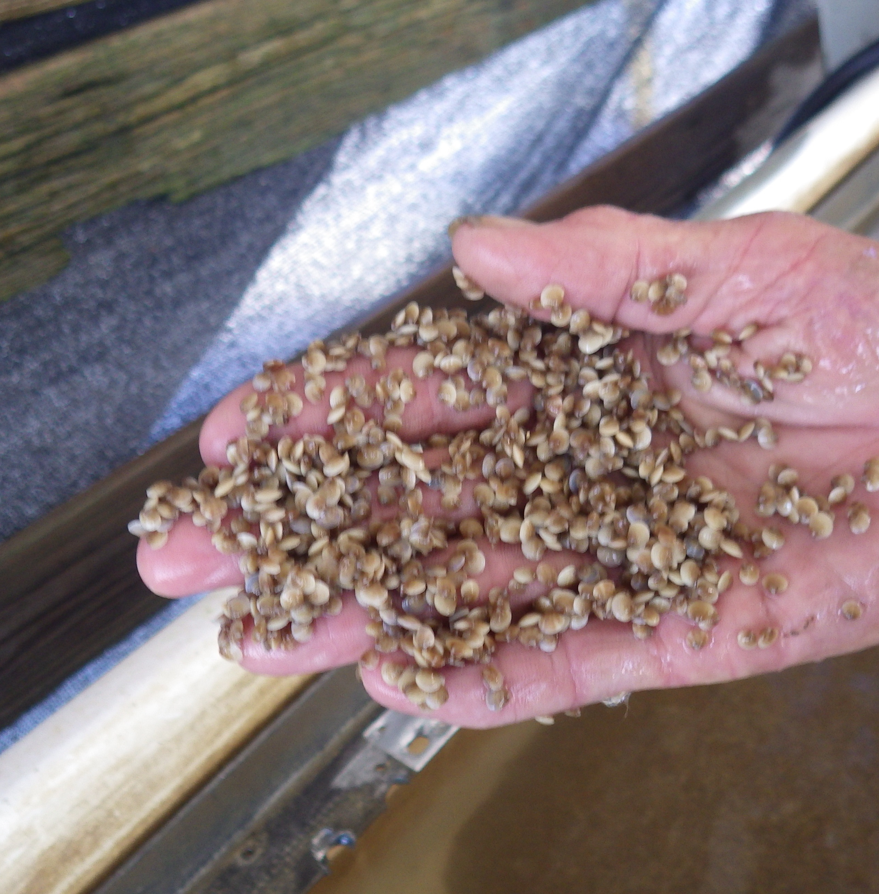
Notes:
Typical hatchery utilizing up-wellers for growing seed. This site is located in Cedar Key FL. Up-wellers are commonly used and seed is graded and sorted as it grows.

Slide 8
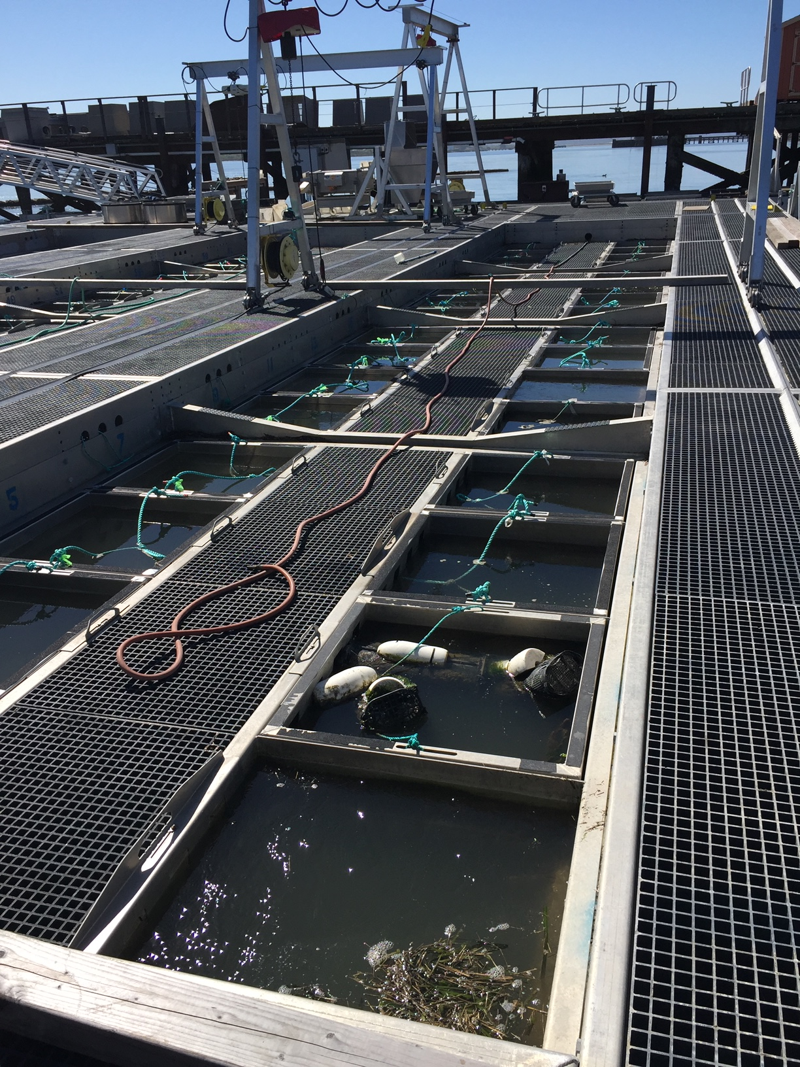
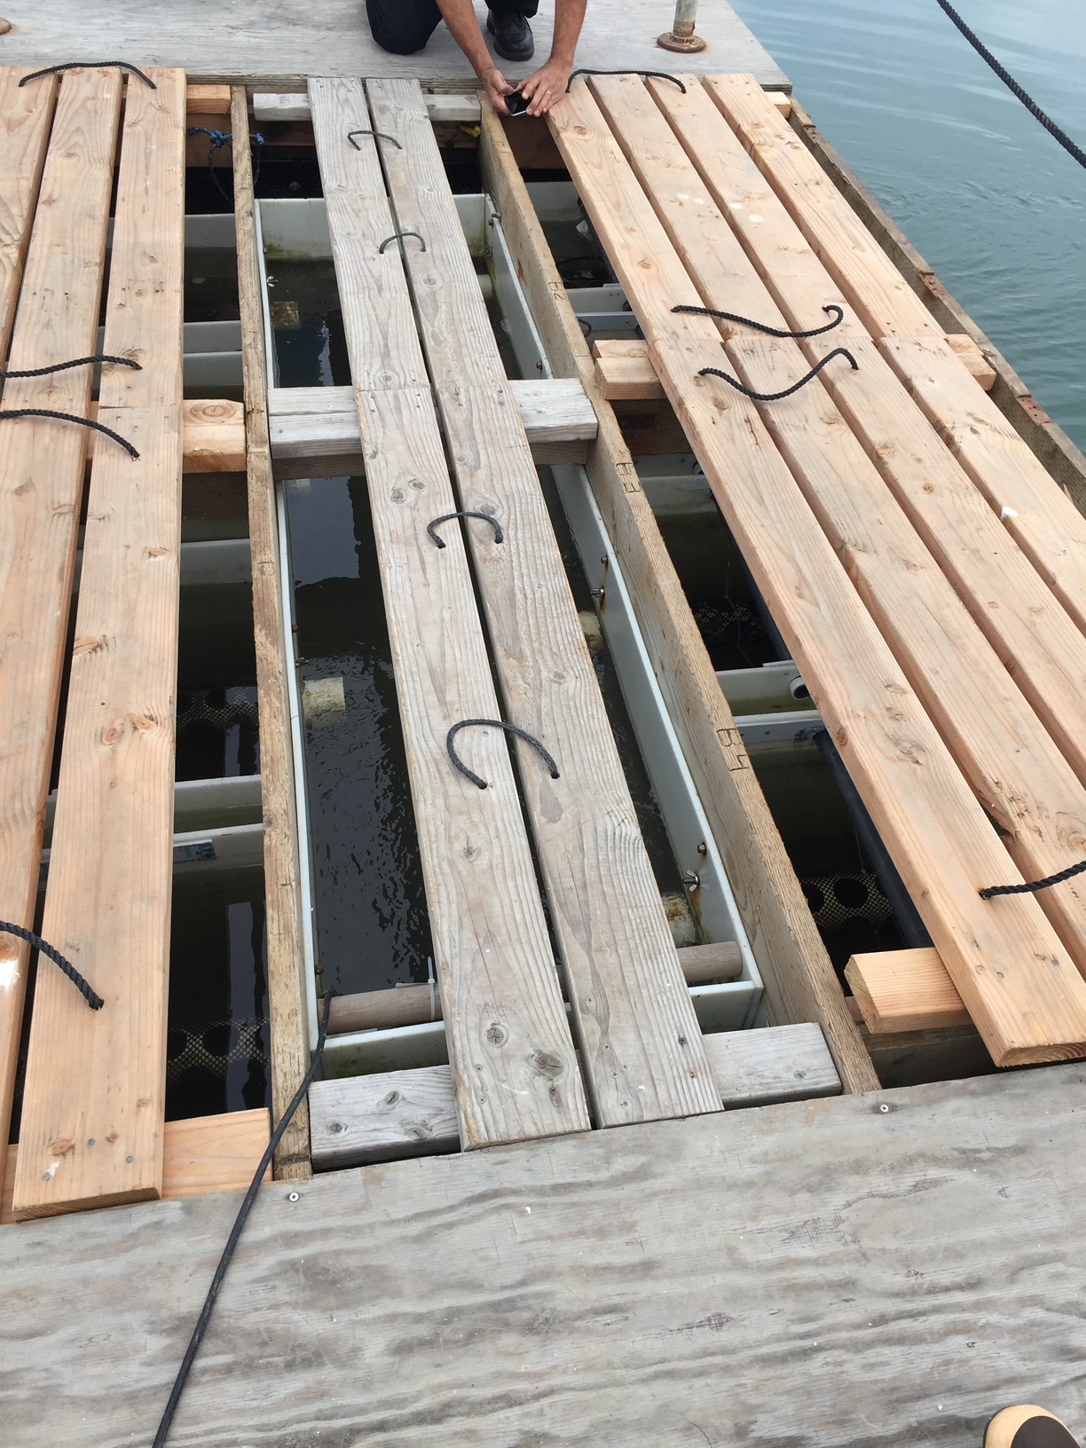
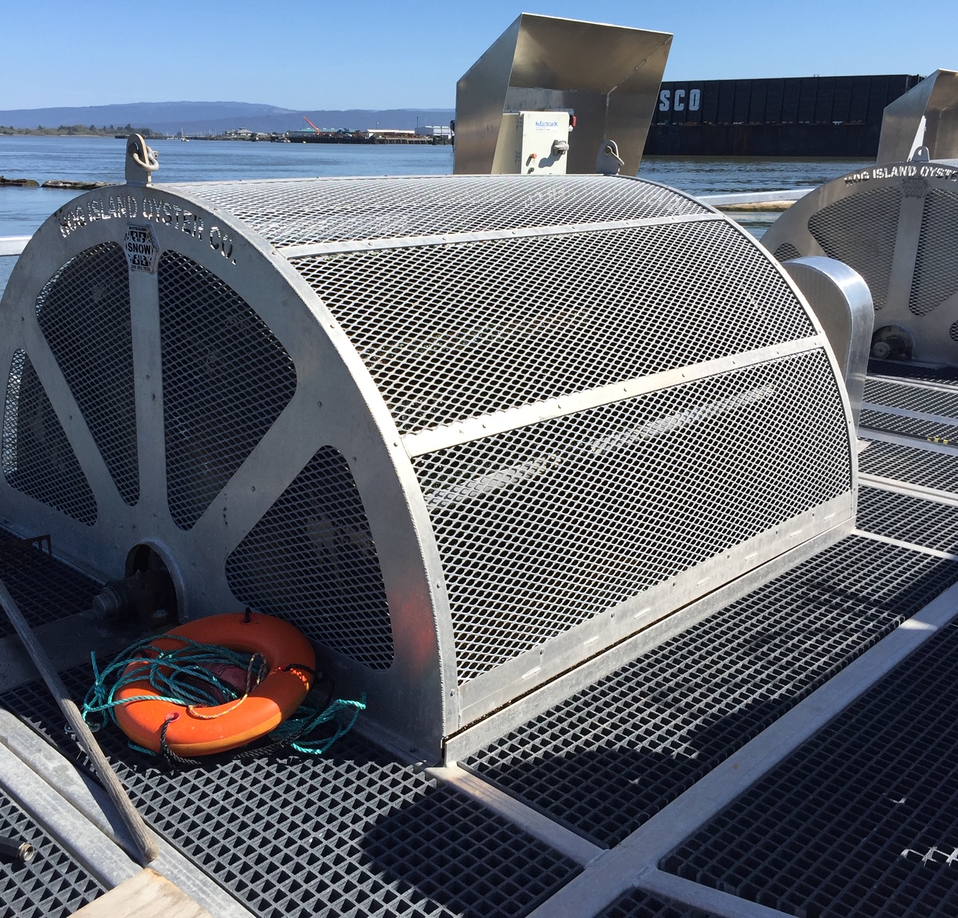
Notes:
More floating up-weller systems (FLUPSYs)
Left Photo is a small variety (Agua Hedionda Lagoon) and Right upper photo is a large system (Humboldt Bay).
Bottom Right Photo: Paddle Wheel moving water.

Slide 9
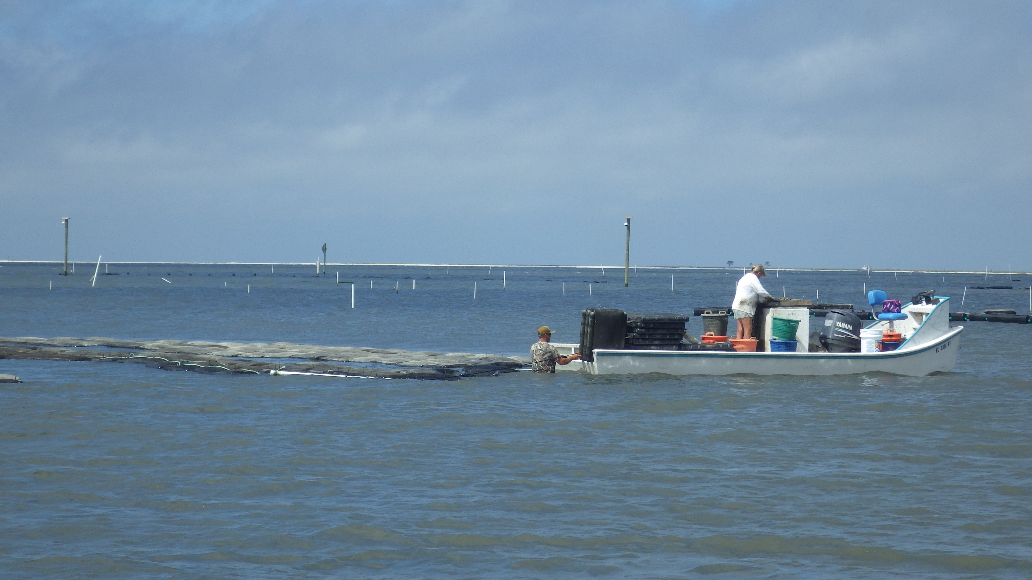
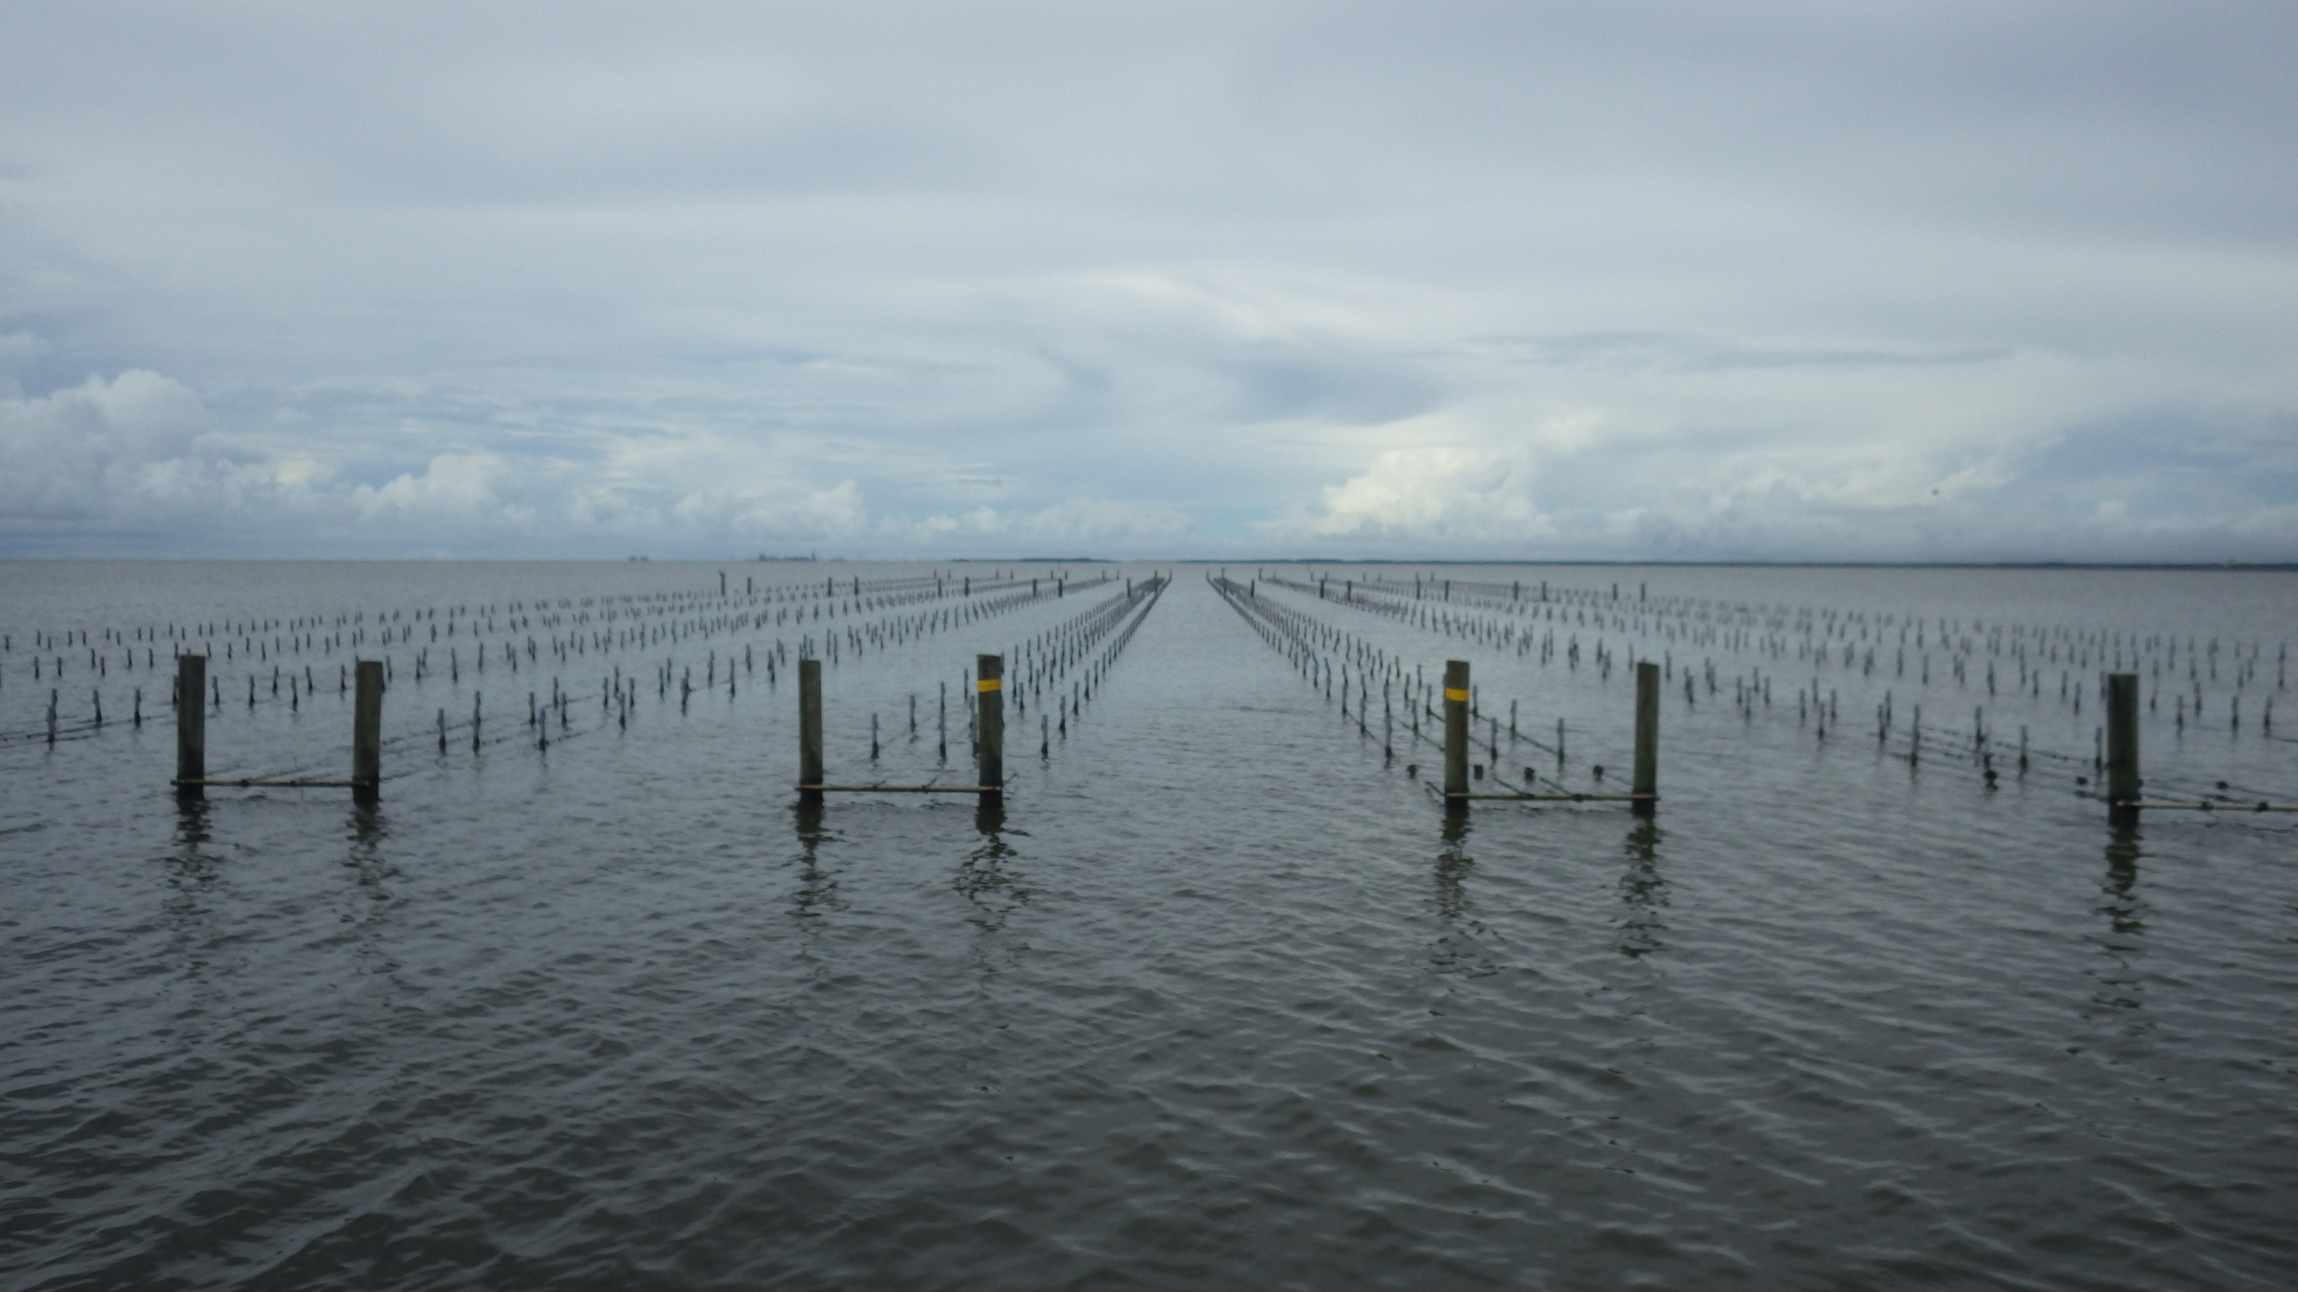
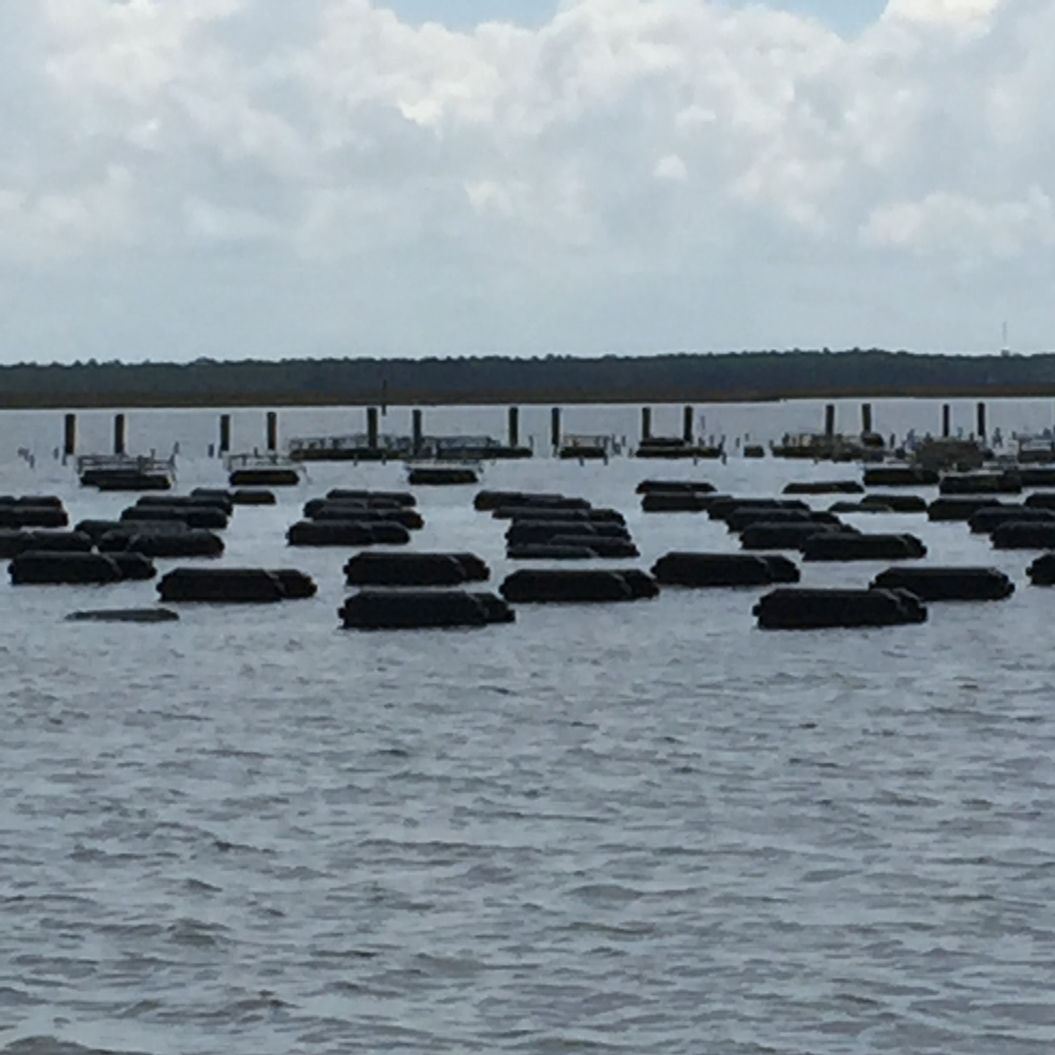
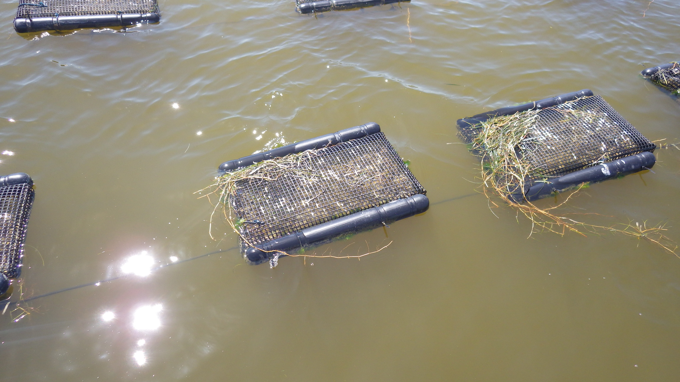
Notes:
Typical aquaculture site. Top left shows AQ site utilizing floating baskets in raft orientation. Middle left shows AQ site utilizing oyster grow cages which can be flipped to allow for desiccation. Bottom left shows AQ site utilizing floating baskets attached to long lines. Picture on right shows AQ site utilizing Australian long lines system where baskets are clipped onto the long lines and hang in water column. Lines can be lifted above water to allow for desiccation.

Slide 10
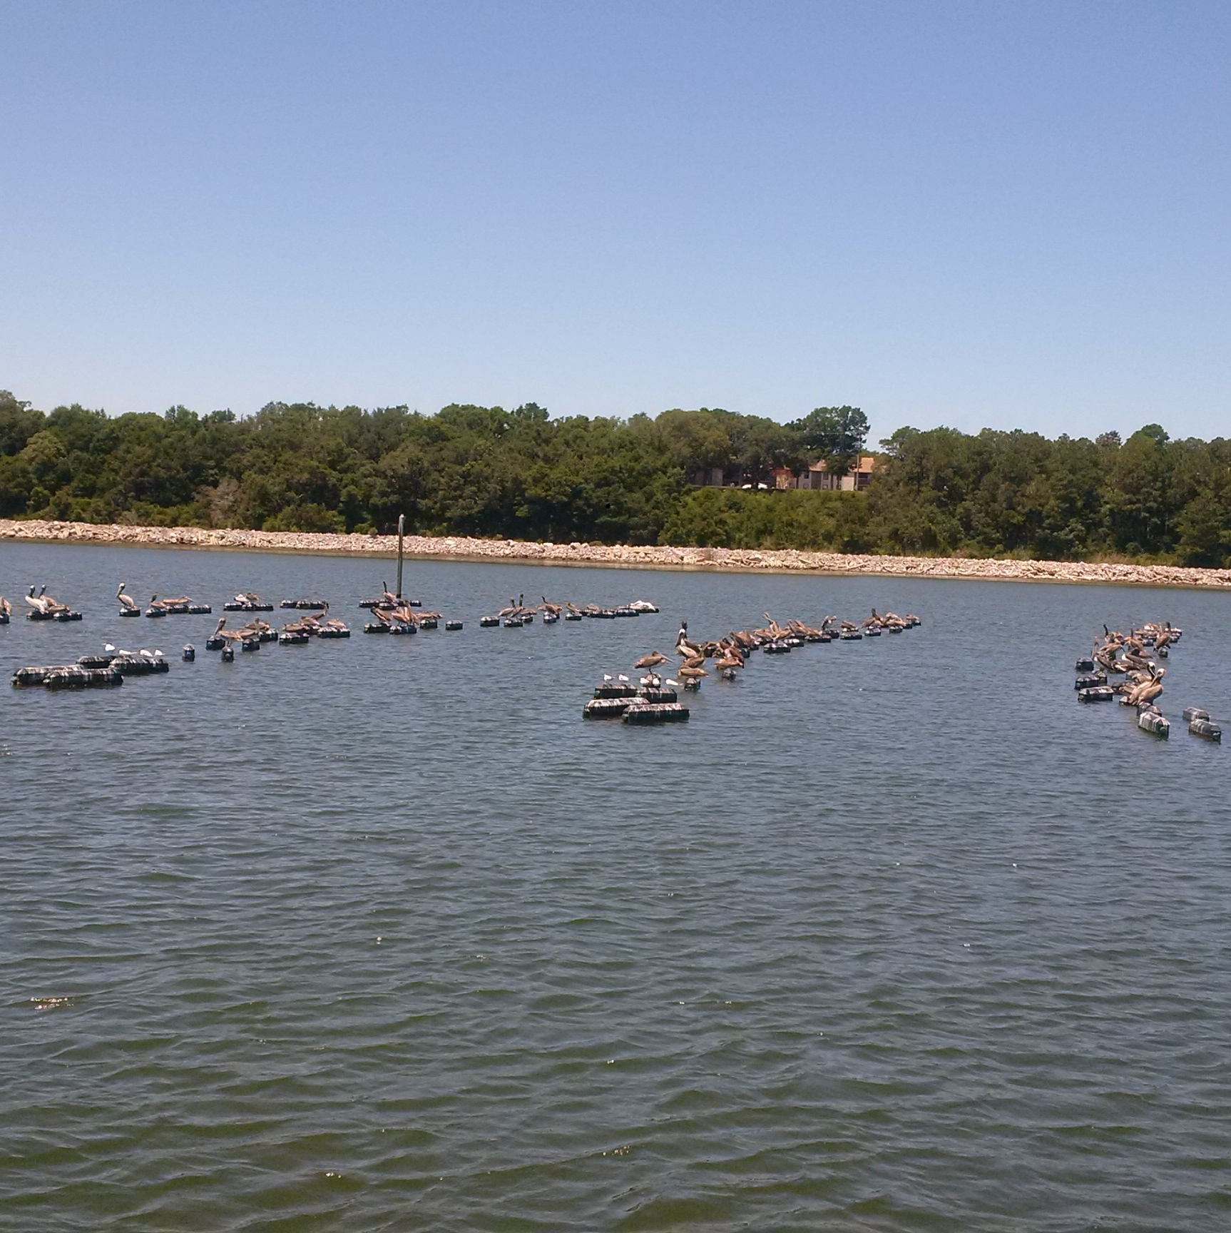
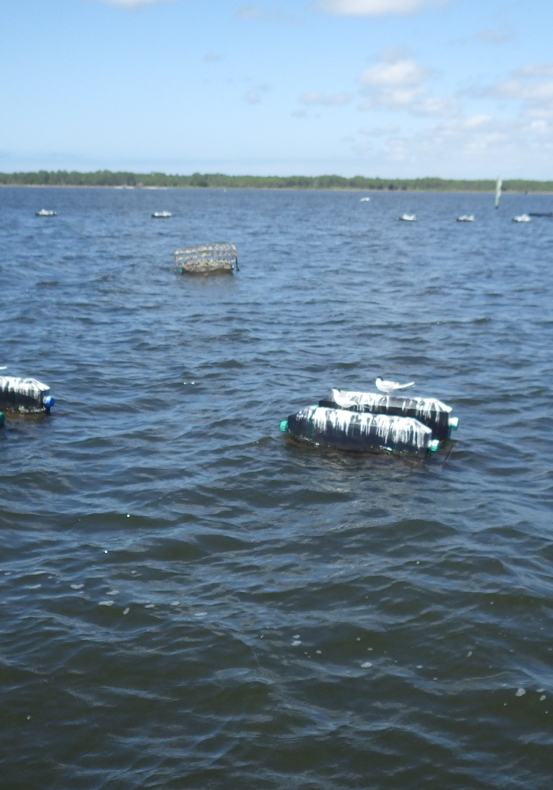
Notes:
Oyster grow cages that indicate significant impact from bird activity. Mitigation should be implemented to reduce the impact from bird activity.

Slide 11
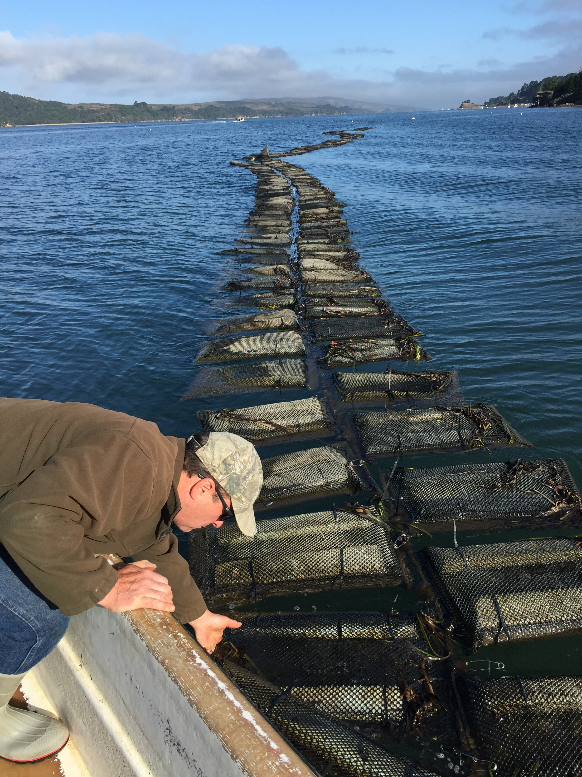
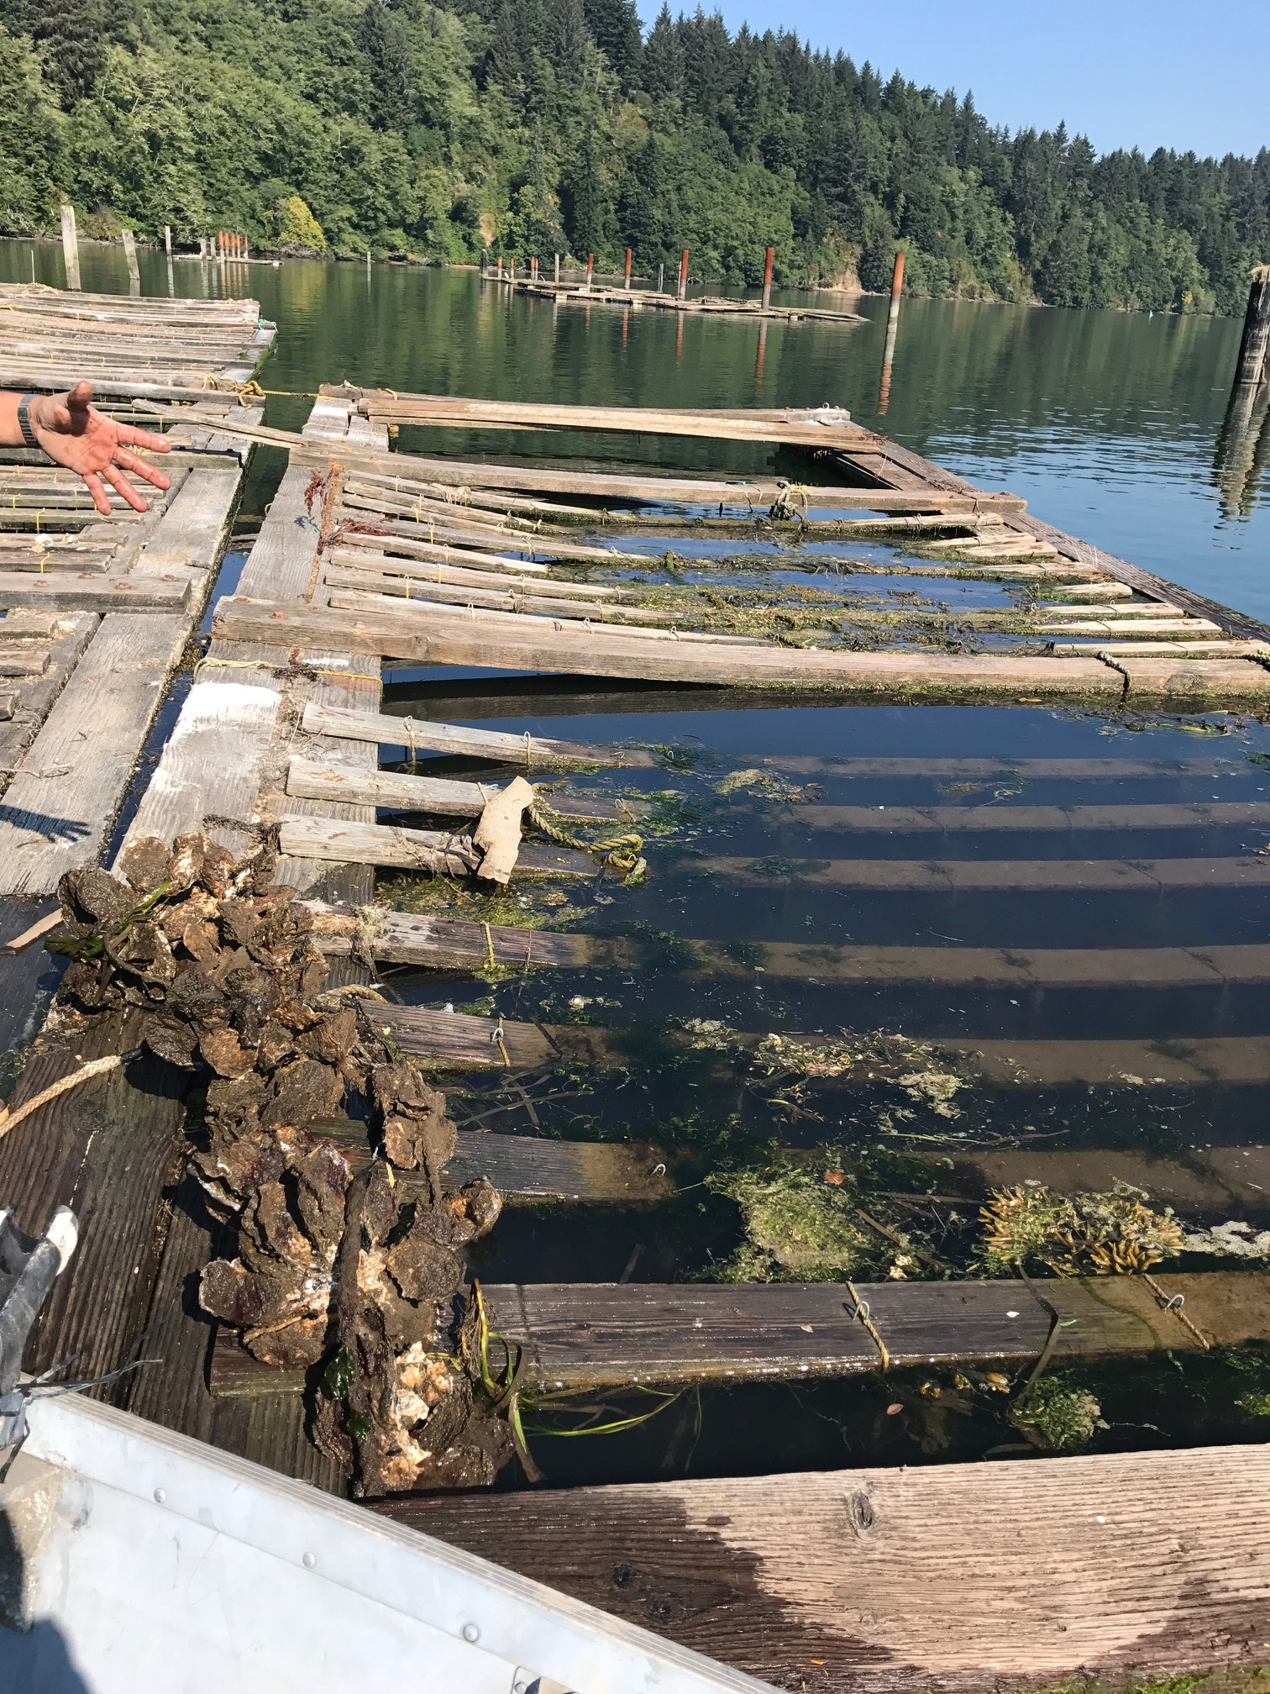

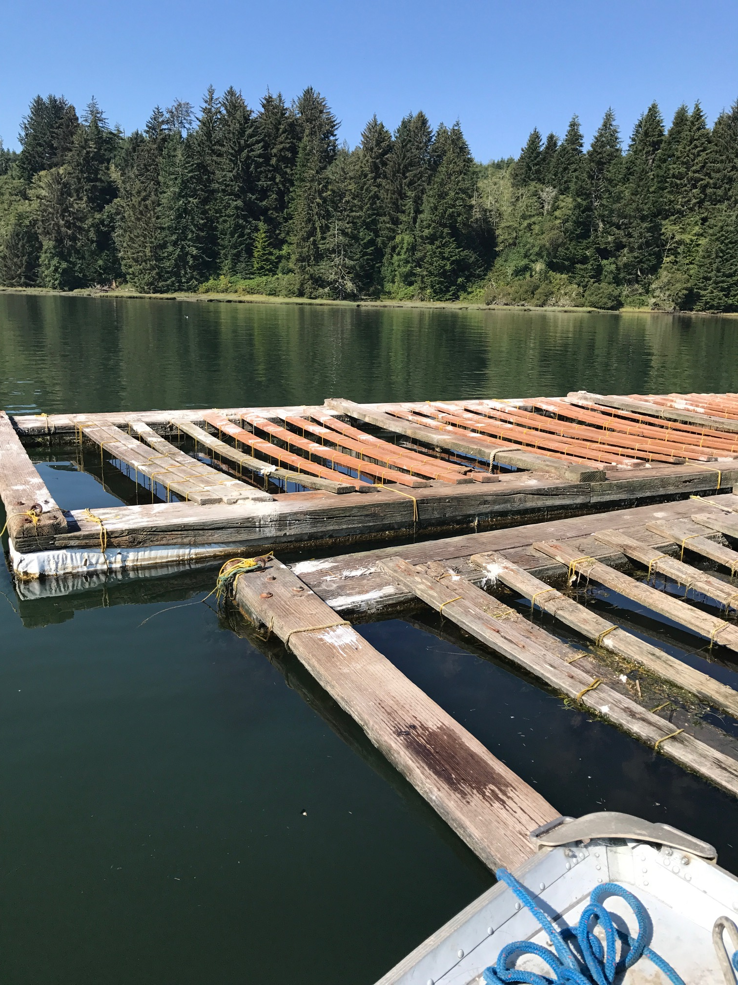
Notes:
Floating bag culture (Tomales Bay)
Sink Floats in Yaquina Bay. The top right photo shows damage from pinnipeds that lay on top of the floats. Bottom right photo shows evidence of feces from pinnipeds and birds

Slide 12
Harvester/Dealer Requirements
Exceptions:
Hatcheries and nurseries located in approved or conditionally approved waters are exempt.
Hatcheries and nurseries located in restricted or conditionally restricted growing areas are exempt but are subject to relay requirements for seed that exceeds the maximum size established by the Authority
Notes:
Hatchery exemptions…
Hatcheries and nurseries for larvae and seed that are located in approved or conditionally approved waters are exempt from these requirements.
Hatcheries and nurseries that are located in restricted or conditionally restricted growing areas are exempt, but are subject to relay requirements found in Chapter 5 for seed that exceeds the maximum size established by the Authority.
Many states will still permit these facilities but they would not be something that would be required by the NSSP MO.

Slide 13
General
Harvester/
Dealer
Requirements
Permitted by Authority, have a harvester license and certification as a dealer where necessary.
Operated within provisions of the permit and based on operational plan.
Obtains permission from Authority prior to using facility
Seed that exceeds maximum seed size shall be subject to relay or depuration prior to direct market … restricted, conditionally restricted, conditionally approved closed.
Only drugs sanctioned by the FDA used in shellfish treatment.
Meets NSSP harvest, processing, storage, shipping requirements … raised in land based system, exceeds market size ….
Records maintained for 2 years that include source of seed. For land based systems, the water source, its treatment, if necessary and the quality.
Notes:
Any person who performs AQ, as we have now defined it in the MO, must have their sites permitted by the Authority and must have a harvester license. In addition, the Authority may require them to be a certified dealer.
These AQ sites must be operated within the provisions of the permit and based on the authority approved written operational plan.
Prior to use the authority must grant permission.
If seed exceeds the set maximum seed size, it must be subject to relay or depuration prior to direct market if the culture area or facility is located in or using water which is restricted, conditionally restricted, conditionally approved closed.
**If you are questioned about the corrective actions mentioned earlier, remind them that is for seed produced in prohibited areas and it my still have 120 grow out.**
Only drugs sanctioned by FDA are allowed to be used to treat shellfish.
Harvesting, processing, storage and shipping requirements for seed facility and land-based AQ facilities must meet requirements of Chapters V, VII, VIII, IX, X, XI, XII, XIII and XIV.
Records that include source of seed and for land-based systems, water source, its treatment and if necessary, water quality, must be maintained for two (2) years.

Slide 14
Seed Production in Water Classified as Prohibited or Unclassified
Seed may come from any growing area …
  Seed from waters classified as prohibited or unclassified is sanctioned by the Authority; and
  Each AQ site that cultivates seed in prohibited or unclassified waters has an written operational plan approved by the Authority prior to it implementation.
Notes:
Remember that seed may come from any growing area. Seed from waters classified as prohibited or unclassified must be sanctioned by the Authority, as well as, each AQ site must have a written operational plan approved by the Authority.
AQ activities must be approved PRIOR to beginning operations.

Slide 15
Aquaculture that Attracts Birds or Mammals
Each AQ site that the Authority determines may attract sufficient birds or mammals that their waste presents a human health risk shall have a written operational plan approved prior to is implementation.
Notes:
Key words here are “MAY ATTRACT BIRDS OR MAMMALS” . This is subjective, but most floating AQ systems, will attract birds at some point during their use. It is much easier to obtain written operation plans as part of initial permitting. Many states will already require every AQ site to be permitted.

Slide 16
Land Based Aquaculture
Each land based AQ site must have a written operational plan approved by the Authority prior to it implementation.
  Operational plan
  Maintain construction and site plans
  Aquaculture permits
  Water systems. Flow through systems using approved or conditionally approved water from a growing area may be sold to direct market.
  Water quality in closed or recirculating systems must meet the requirements of Chapt VII. .04 C. (3) or shellstock shall be relayed or depurated.
Notes:
No significant change to this section.
The facility must obtain approval from the Authority prior to implementation and must maintain an operational plan, construction and site plans, as well as, aquaculture permits. In addition, for water systems that are flow through systems using approved or conditionally approved water from a growing area, this product may be sold to direct market. Water quality in closed or recirculating systems must meet the requirements of Chapter VII. .04 C. (3) or be relayed or depurated.

Slide 17
Operational Plans
Description of the design and activities of the site or facility.
Specific site and boundaries.
Types and locations of any structures, including rafts, pens, cages, nets …
Species of shellfish to be cultured and harvested.
Procedures to ensure no poisonous or deleterious substances are introduced.
Each AQ activity may have additional specific requirements.
Notes:
Each facility must have a written operational plan. The facility must obtain approval from the Authority prior to implementation and must include the following…
Description of the design and activities of the site or facility.
Specific site and boundaries.
Types and locations of any structures, including rafts, pens, cages, nets etc.
Species of shellfish to be cultured and harvested.
Procedures to ensure no poisonous or deleterious substances are introduced.
And remember that each AQ activity may have additional specific requirements.

Slide 18
Polyculture Systems and Aquaculture in Federal Waters
No change to the Polyculture section.
Requirements for harvesters in Aquaculture in Federal Waters was added with similar requirements as other state water AQ sites.
Notes:
There were no change to the polyculture section. All polyculture systems must follow the requirements for Land-based systems. They must also provide information concerning all sources and species of all organisms to be cultivated, cultured and harvested. In addition, there are also a couple of additional operation plan requirements.
Federal waters requirements are similar to requirements of state waters, but will not be covered in detail.

Slide 19
FDA Evaluation of State Program
  State AQ regulations pertaining to AQ and seed production.
  Operational plans for seed production in prohibited waters, AQ structures that may attract birds or mammals, land based AQ.
  Permits and records to ensure that operational plans are being implemented.
Notes:
Overview of FDA Program Review. Will be completed as part of the Control of Harvest Evaluation.
FDA will be reviewing State regulations pertaining to AQ and seed, reviewing operational plans for seed produced in prohibited areas, as well as, operational plans for AQ structures that may attract birds or mammals. Finally, FDA will be looking at permits and records to ensure that operational plans are being implemented. As a reminder, for bottom plant operations, risks are evaluated through the GA evaluation and harvest activities are evaluated through Vibrio evaluations, as well as, other areas of the Control of Harvest evaluation.

Slide 20
Records
Operational Plans
Inspection Reports
Lease Activity Reports
Harvest Activity Reports
Re-submergence Records
Bacteriological Water Quality Data
Shellfish Bacteriological Quality Data
Seed Records
Notes:
Typical records that may be reviewed during FDA Program evaluation.

Slide 21
Questions?
Notes:
Questions?

