Slide 1
Vibrio parahaemolyticus
Risk Assessment Updates
ISSC Vibrio parahaemolyticus Workshop
Baltimore, MD
September 6, 2017

Slide 2
FAO/WHO Working Group
Lead: Angelo DePaola
FAO: Sarah Cahill, Iddya Karunsagar
WHO: Rei Nakagawa
Team
  US: John Bowers, Narjol Gonzalez-Escalona, Kristin DeRosia-Banick, Chris Schillaci
  Canada: Enrico Buenaventura
  Chile: Viviana Cachicas
  UK/Spain: Jaime Martinez-Urtaza
  Japan: Mitsuaki Nishibuchi
  New Zealand: Dorothy-Jean McCoubrey

Slide 3
Scope of FAO/WHO Work
Update vibrio epidemiology and risk management controls
  ISSC
  Canada
  States (CT, NY, MA, WA, Gulf)
  Other countries
Assess skill of vibrio risk models for bivalve mollusks (examples)
  Exposure
  Risk characterization
Emerging risk management tools
Recommendations for future work
Notes:
Enrico has provided documents and links to Canadian vibrio controls. Ken Moore has agreed to extract controls and guidance text addressing vibrios from Model Ordinance and prepare a single document for our report. These are currently addressed in multiple sections spread throughout the MO and are difficult to access. CT and WA have implemented proactive controls far beyond ISSC requirements. Should these be provided in full text as appendices, links or both? Controls in other countries do not appear to rely on vibrio risk models. Maintenance of cold chain after refrigeration is typically required for international trade but times to refrigeration after harvest does not appear to be mandated outside US and Canada. Consumer education to cook shellfish appeared to be effective after a large Vp outbreak in Chile. Remaining points addressed in following slides.

Slide 4
Are exposure models skilled for Vp and Vv in bivalve mollusks?
Water temperature influence
Post-harvest growth rate
Regional variability
Seasonal variability
Year to year variability
Shellfish species
Issues/Artifacts
Notes:
Each of these factors will be considered in the analysis of this question.

Slide 5
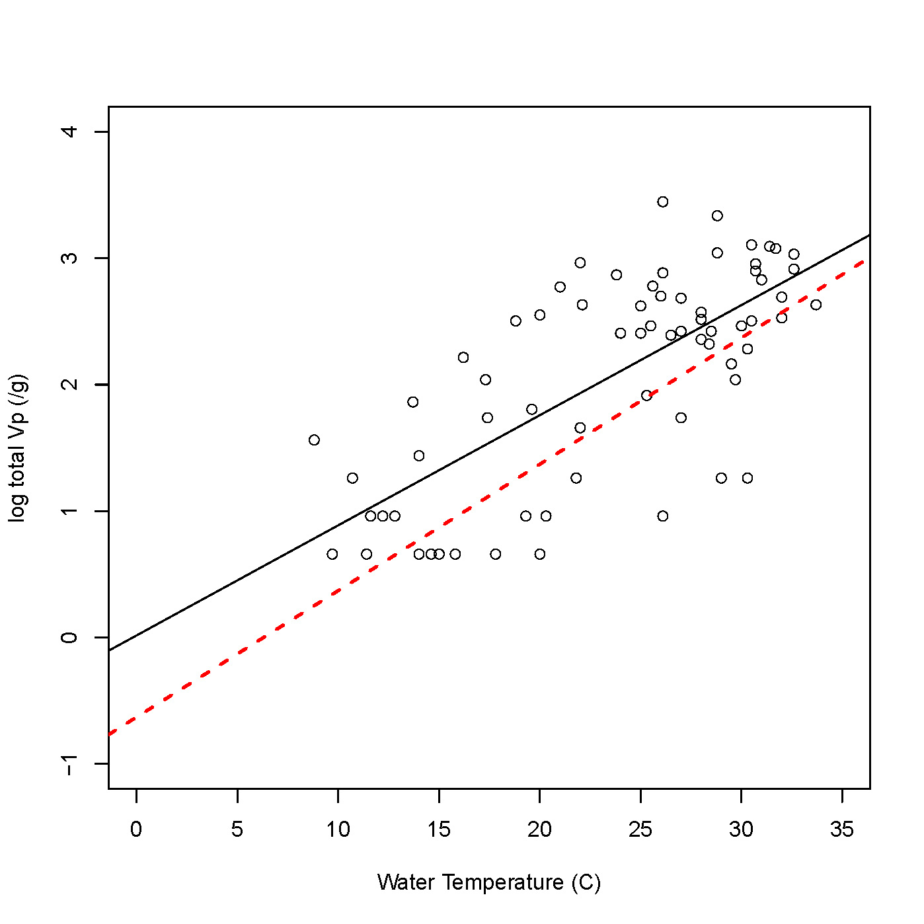
Effect of water temperature on V. parahaemolyticus levels in Mississippi oysters
Johnson et al 2010
VPQRA: red dashed lines
MS observations: black circles/line
Observed data slightly higher than VPQRA
Possible artifacts
  VPQRA: No MS data
  9/70 non-detects plotted at LOD
  Direct plating DNA probe
Notes:
This graph shows data from Johnson et al study of the relationship between Vp levels in in MS oysters and water temperature (black dots and line) relative to VPQRA predictions (red dashed line. MS data suggests a similar relationship between Vp levels and water temperature as model prediction but with slightly higher Vp levels. The slope of the line may be influenced by using the LOD for non-detect samples.

Slide 6
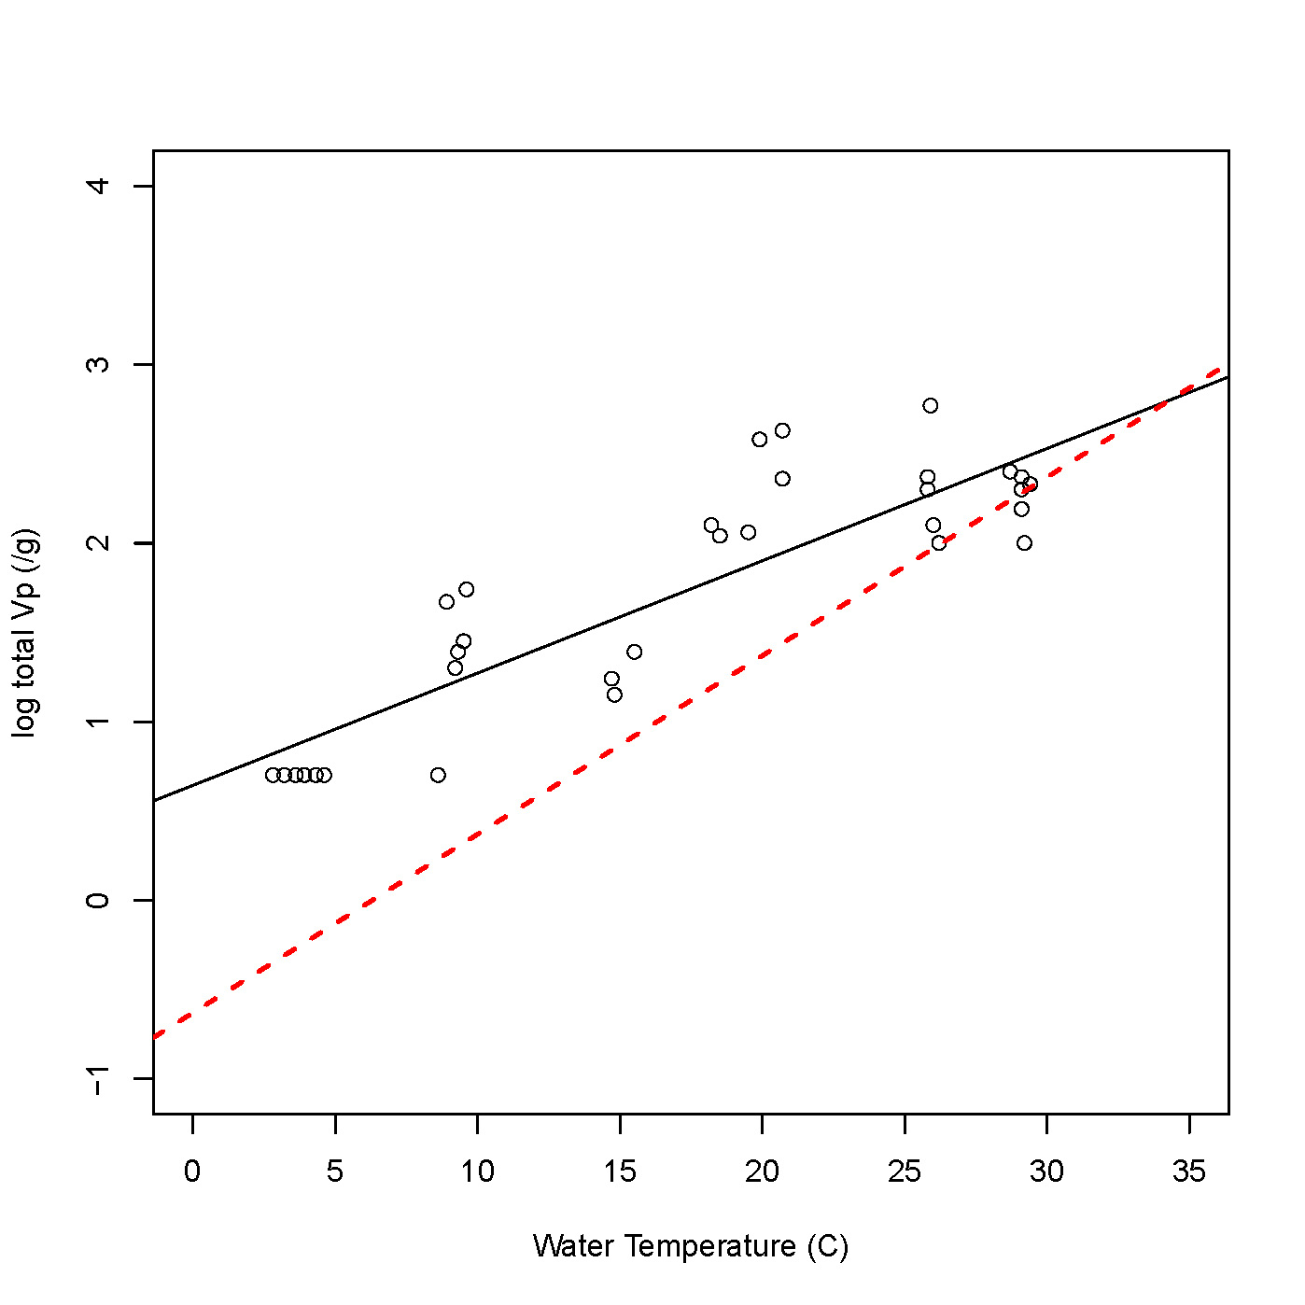
Influence of water temperature on V. parahaemolyticus levels in Chesapeake Bay (MD) oysters
Parveen et al 2009
VPQRA: Red dashed line
MD Observations: black circles/line
Observed values less influenced by water temperature and greater than VPQRA especially at lower temperatures
Issues/artifacts
  Non-detect plotted at LOD
  MD data not in VPQRA

Slide 7
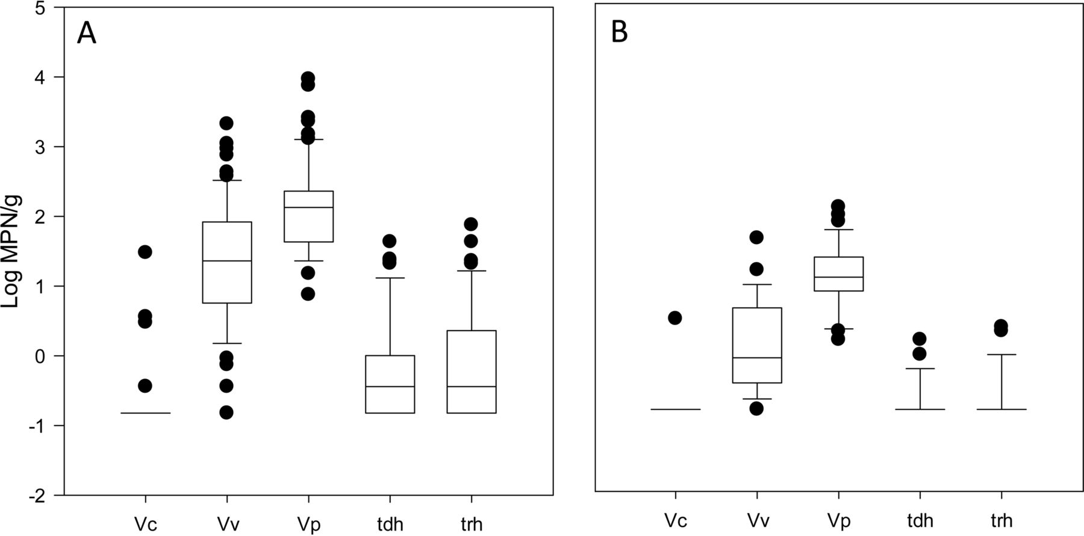
Vibrio levels in Oysters & Clams
Jones et al 2014 AEM
Paired sampling
  C. virginica (A)
  M. mercenaria (B)
Long Island Sound 2012-13
Vc, Vp and Vv harvest levels ~ 1 log higher in oysters than clams
Issues/artifacts
  Relatively few samples
  Single estuary
Notes:
Since the release of the VPRA in 2005, clams (M. mercenaria) from the NE Atlantic Coast have been increasingly implicated in Vp illnesses. This slide compares Vc, Vv and Vp (total and tdh+) levels in clams collected from CT and NY in 2012 and 2013. Vibrio levels appear to be ~ 1-log higher in oysters than clams in this study (Jones et al)

Slide 8
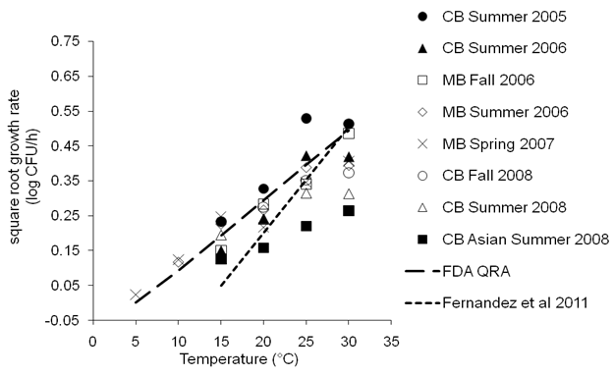
V. parahaemolyticus growth in various regions, seasons, years and shellfish species
Notes:
This figure is from Parveen et al and illustrates considerable variability in Vp growth rates in different regions, seasons, years and shellfish species. The VPQRA model relied on Vp growth in oysters collected from Mobile Bay and stored at 26C relative to growth rates in broth cultures at various temperatures. Vp growth in both Mobile and Chesapeake Bay oysters in this study agreed reasonably well with VPQRA growth models up to 25C but growth appeared to plateau at higher temperatures. Parallel studies in Chesapeake Bay during the summer of 2008 indicated slower growth of Vp in the Asian oyster, C. ariakensis, than in C. virginica during this period and much slower growth than VPQRA model predictions, especially as temperatures increased. In a separate study of C. gigas in Australia, Fernandez et al reported Vp growth to be slower than VPQRA model until temperatures approached 30C when similar growth was observed to VPQRA model. This study also reported a lack of Vp growth in the Sydney Rock oyster.

Slide 9
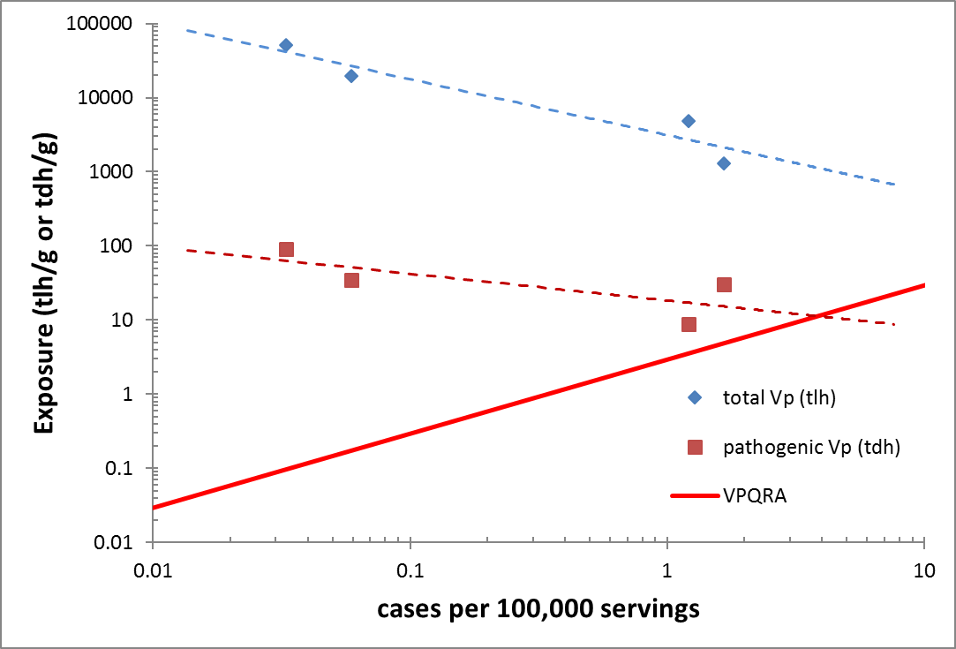
Vp Exposure Between USA Coastal Regions Not Predictive of Risk
Notes:
This slide illustrates inverse relationships between VPQRA predicted risk and observed relationship between risk and exposure to either total or pathogenic Vp during peak levels and risk for each region (summer for Atlantic and Pacific and spring and summer in Gulf). Greatest exposure and lowest risk was observed in Gulf summer followed by Gulf spring (furthest 2 points on right side). The lowest exposure to total Vp and highest risk was observed in Pacific summer (furthest left point). Pathogenic Vp levels in the Pacific were higher than in the Atlantic and Gulf spring but not Gulf Summer that had lowest observed risk. Total Vp levels were ~1 log higher in Gulf than in Pacific or Atlantic but the risk was >10-fold greater in these regions. A similar but less inverse relationship is illustrated between observed regional levels of pathogenic Vp exposure and observed risk. The higher observed risk for pathogenic Vp for all points than indicated by VPQRA dose response line is partially attributed to VPQRA assumption of a 20 to 1 under-reporting factor that was not applied to the observed data.

Slide 10
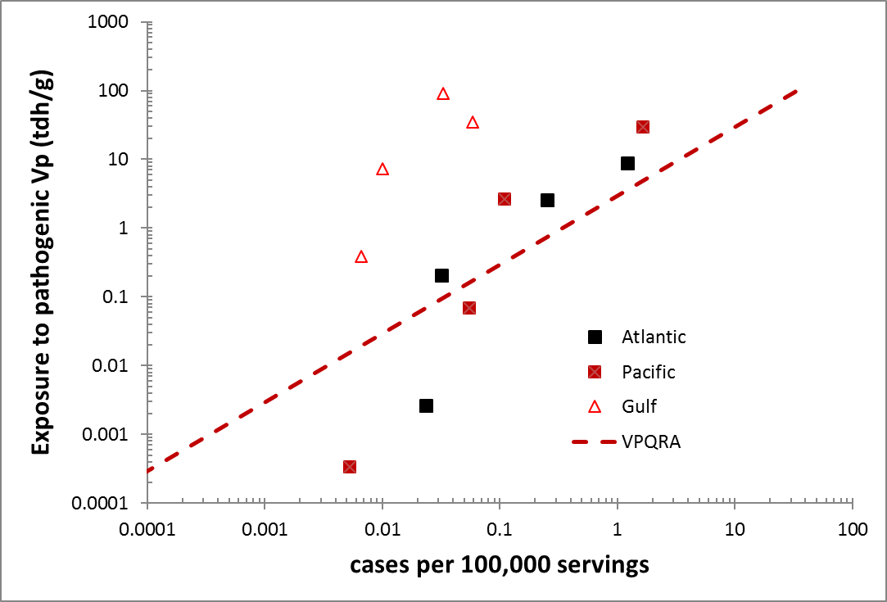
Seasonal Vp Exposure Predictive of Risk Within US Coastal Regions
Notes:
While the previous slide indicated an inverse relationship for Vp exposure and risk during peak risk seasons for different US regions, this slide show that within each coastal region, observed risk is well correlated with exposure. A similar relationship between risk and exposure appears for the Atlantic and Pacific while the Gulf Vp population appears to be less infectious.

Slide 11
Notes:
This table was produced by the USFDA as part of the public health rationale supporting their ISSC proposal 13-204 requesting a national mandate for rapid cooling to 50F (10C) within one hour of harvest. VPRA models were used to predict the regional reduction in reported Vp illnesses and the economic benefit of implementing this rapid cooling proposal relative to the baseline at that time. The predicted illness reductions for Vp ranged from 90-95% in the various regions. The economic benefits do not account for the under-reporting, which is estimated by CDC to be >150:1 for Vp nor the reductions for Vv illnesses. This proposal was substituted for a proposal for further study on alternative controls at the 2013 ISSC meeting by FDA due to lack of support by state shellfish control authorities.

Slide 12
Illness History in Connecticut:
2009 to 2014 Illness Summary
Year | Confirmed CT Cases | Multi-State Including CT
2009 | 1 | 2
2010 | 1 | 2
2011 | 1 | 2
2012 | 1* | 3
2013 | 23** | 11
2014 | 1 | 2
*2012 Closure of Westport/Norwalk growing area from 7/15/12 through 9/19/12
** 2013 Closure of Westport/Norwalk growing area from 8/2/13 through 9/16/13
Notes:
After extended closures in 2012 and 2013 due to illnesses from the invasive Pacific O4:K12 outbreak strain , CT enacted rapid cooling controls in 2014 requiring oysters harvested from outbreak areas to be cooled to 50F within one hour.
Vp illnesses attributed soley to CT shellfish dropped from 23 in 2013 to 1 in 2014 and 2 in 2015. (Kristin please update with 2015 data)

Slide 13
Occurrence or introduction of “outbreak strains” drive risk
TX 1998 - O3:K6
  416 cases (98 culture confirmed)
  Few sporadic illness before and after 1998
Chile 2006-2008 – 03:K6
  >10,000 Vp illnesses
  <100/yr since 2013 and most years since 2009
US NE Atlantic 2012-2013: O4:K12
  >100 illnesses
  Unprecedented closures/recalls
  Few sporadic illnesses prior to 2012
  O4:K12 remains dominant strain but rapid cooling reduced illness rates since 2014
Notes:
The 2005 VPQRA models were constructed to address sporadic Vp illnesses and not outbreaks. It has become increasingly apparent that the emergence or introduction of highly infectious “outbreak” strains presents the greatest threats to public health and that the regulatory responses of prolonged closures and costly recalls are most disruptive to industry. Unprecedented outbreaks have occurred repeatedly in the US and other countries where consumption of raw oysters and other bivalve mollusks is prevalent during warmer periods of the year.

Slide 14
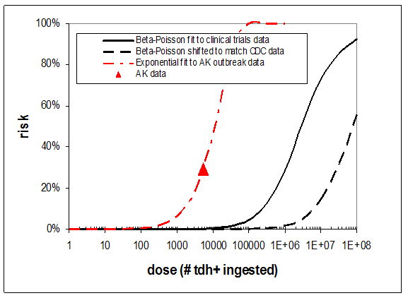
Range expansion of outbreak strains due to warming of waters at higher latitudes represents greatest threat
Notes:
In 2004 an oyster-associated Vp outbreak in AK and was linked to a warm water climate anomaly, which expanded the geographical range of Vp illnesses ~1000Km northward. The initial illnesses were identified from passengers on a cruise ship in the Prince William Sound that consumed oysters from a local farm. A retrospective study that interviewed passengers from 3 consecutive cruises in July 2004 found that ~30% of individuals that consumed 1-6 oysters presented with symptoms consistent for Vp after a culture confirmed cases was identified in NV from a cruise passenger returning home. On the next cruise, samples were collected from the farm and tested for Vp. Mean Vp levels were ~10/g and most isolates matched the serotype and pulse-type of the outbreak strain. This slide is from Martinez-Urtaza et al and compares the VPQRA dose response to the dose observed among ill cruise passengers assuming the Vp levels in samples tested within a week of those implicated were representative of the outbreak. It was also assumed that beta Poisson curve of the VPQRA was applicable to the single AK outbreak data point for a 30% attack rate and that all outbreak illnesses were reported. This analysis indicates that the observed risk was ~10,000-fold higher that the VPQRA prediction.

Slide 15
Emerging technology capable of forecasting vibrio levels and risk on global scale
https://coastalscience.noaa.gov/products/vibrioforecast/default
  User name: opcdata
  Password: M@rine2012!
  Vibrio doubling times
  Vp vs water temperature
Other vibrio forecasting products
Notes:
This link it to all NOAA vibrio forecasting products and includes Long Island Sound, Delaware Bay, Chesapeake Bay, Tampa Bay, Northern Gulf of Mexico Coast, and Puget Sound. Products vary from site to site and include forecasted Vv levels in water, Vp levels in oysters and Vp doubling times in oysters.
Jaime needs to add link and text for other vibrio forecasting products.

Slide 16
Emerging Pre-Harvest Purging Controls
High salinity not effective for Vp purging
Cold water transfer reduces Vp levels and risk
  AK lowered gear following 2004 outbreak
  Katama Bay, MA oysters “transplanted” in cooler Atlantic Ocean waters 2016 & 2017
  Land base and off-shore work in Pacific NW
  British Columbia consistentlyreduces to <100/g
Need greater reliance on guidance and less on Vp testing

Slide 17
Conclusions
Expanded body of knowledge relevant to vibrio risk model assumptions and predictions
Application of vibrio risk assessment models for risk management in bivalve mollusks primarily in USA and Canada
Exposure models demonstrate mixed skill due to high variability Vp and Vv levels in USA oysters
Vibrio levels at harvest varies between shellfish species (e.g. oysters and clams)
Post harvest vibrio growth varies between shellfish species (e.g. C. virginica, C. gigas, C. arikensis, Sydney rock oysters)
Total and pathogenic Vp levels are not predictive of risk between different USA regions
Seasonal level of total and pathogenic Vp are predictive within regions of USA
Rapid cooling reduces Vp risk relative to vibrio growth models
Occurrence or introduction of “outbreak strains” drive risk
Range expansion of outbreak strains due to warming of waters at higher latitudes represents greatest threat
Emerging pre-harvest mitigations capable of reducing vibrio exposure
Emerging technology capable of forecasting vibrio levels and risk on global scale

Slide 18
Recommendations
Gather new data and conduct comprehensive analysis for regionalizing risk models
Develop Vp dose response based on regional epidemiology similar to Vv dose response
Support development of globally applicable risk assessment and management tools
  Climate/hydrography forecast models
  Regional risk models based on epidemiology
  Early recognition of introduction/emergence of highly infectious outbreak strains
  Develop BMPs corresponding and proportional to regional and seasonal risk
  Time temperature indicators to verify cold chain
Develop outreach plan to demonstrate risk tools and adapt to local conditions of region

