Slide 1
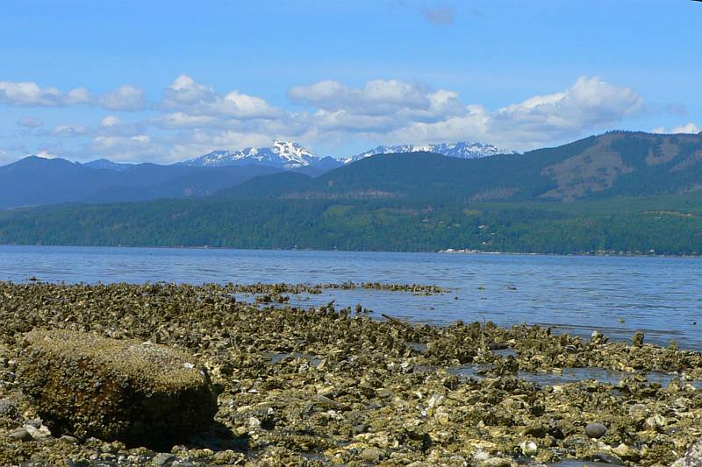
Update: Vibrio parahaemolyticus in the Pacific Northwest
Rohinee Paranjpye, John Jacobs, Clara Hard, Gina Olson and William Glover

Slide 2
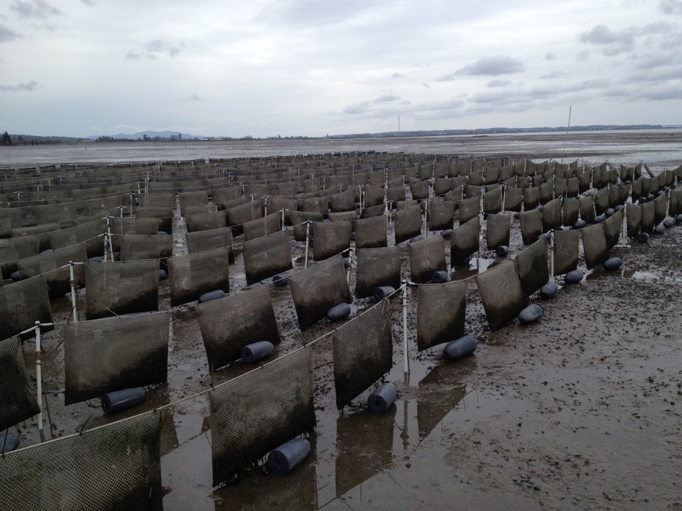
Invasive and Endemic Vp Strains:
Genetic diversity of V. parahaemolyticus strains from the Pacific Northwest

Slide 3
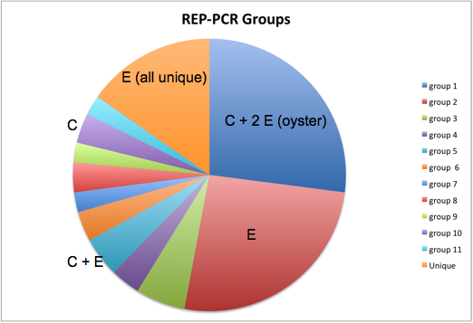
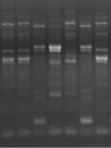
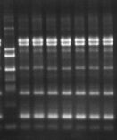
Genetic diversity of V. parahaemolyticus isolates from the PNW
Genotypic comparison of selected environmental isolates (2007-2008) with clinical isolates from WA state and world-wide
  Two typing methods used
    Rep-PCR (Repetitive extragenic palindromic PCR)
    Multi Locus sequence typing
environmental
clinical
includes pandemic
isolate
The majority of clinical isolates from the PNW have a
similar profile that is distinct from that of the pandemic strain
Notes:
Two typing methods were used to compare environmental and clinical strains
REP-PCR- a finger printing method
And MLST- Multi locus sequence typing that is based on sequence analysis of 7 housekeeping genes.
The majority of clinical strains from WA were tdh and trh positive.
A significant proportion environmental strains were tdh positive, trh negative and grouped with clinical isolates from other regions, including the O3:K6 pandemic isolate.

Slide 4
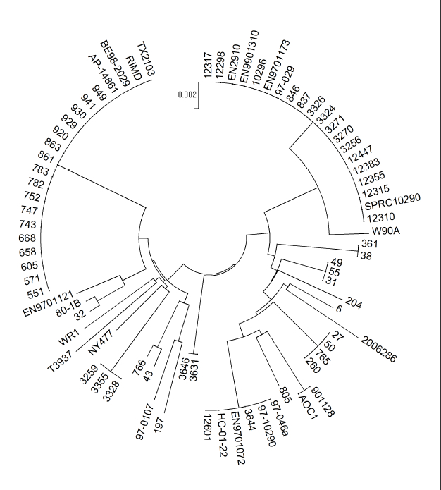
Multilocus sequence typing of
V. parahaemolyticus
(based on 7 housekeeping genes)
pandemic strain
Environmental clade clonally related to the pandemic strain
  tdh+/trh- strains
  clinical strains from other geographic regions
PNW clinical clade
  endemic strains from PNW (largely 2007-2008)
At least 5 other clinical sequence types identified
All clinical strains trh+ but tdh±
  3 new ST’s
PNW
environmentals
PNW clinicals
ST 36
ST 3
ST 138
ST 34
ST 65
ST 417
New ST’s
ST 43
Notes:
Multi locus sequence typing of the same strains showed a similar pattern and confirmed that the environmental strain from the PNW grouped with clinical strains from other geographic regions as well as the pandemic strain

Slide 5
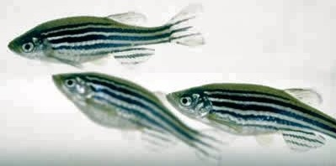
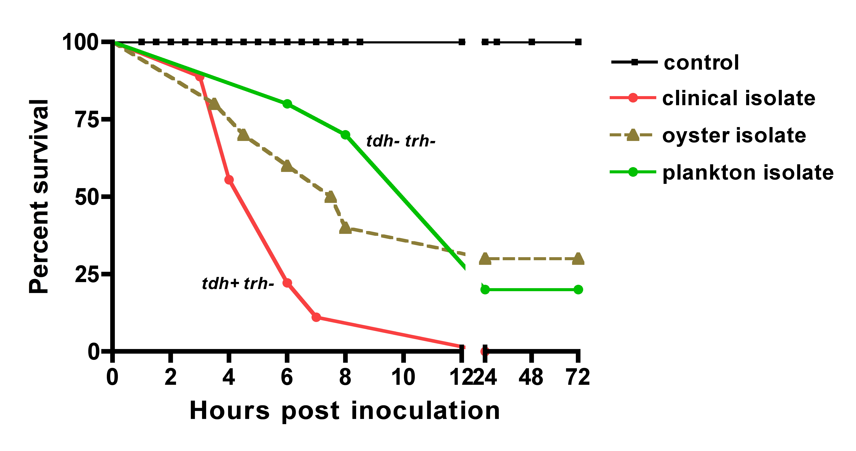
Pathogenic potential of tdh+/trh± environmental strains
Comparison of virulence profiles of strains
using zebrafish as a biomedical model to
characterize differences
  V. parahaemolyticus can infect zebrafish
  in a dose dependent manner
Virulence assessed based on survival time
Notes:
To determine the pathogenic potential of environmental isolates, the virulence potential of both clinical and environmental isolates were compared in a zebrafish model.
Virulence was assessed based on survival time.

Slide 6
Comparison of virulence of
V. parahaemolyticus isolates
Source | Genotype | Survival time (h) | MLST(ST)
Clinical (WA) | tdh+/trh+ | 7.36 ± 2.30 | 36
Oyster (WA) | tdh+/trh+ | 7.50 ±1.09 | 36
Water (WA) | tdh+/trh- | 22.0 ± 0 | 3
Plankton (WA) | tdh+/trh- | 22.0 ± 0 | 3
Clinical (pandemic) | tdh+/trh- | 6.15 ± 1.11 | 3
Significant population of tdh+/trh- (ST 3) environmental
isolates in the PNW that may not be pathogenic
Notes:
The model could successfully identify environmental isolates with a virulence potential similar to clinical strains (see oyster isolate). We found a significant number of Sequence Type 3 environmental isolates that were significantly less virulent as compared to the clinical isolates ( see water and plankton isolate as examples).

Slide 7
Comparison of the genetic and serological profiles of clinical and environmental V. parahaemolyticus strains from Washington State.
Vp strain | Source | Year isolated | ST type | rep-PCR group ^{b} | tdh | trh | orf8 | toxRS (new) | Serotype
551 | water | 2007 | 3 | 1 | + | - | + | + | O3:K6
930 | oyster | 2007 | 3 | 1 | + | - | + | + | O3:K6
605 | net tow | 2007 | 3 | 1 | + | - | + | + | O3:K6
747 | water | 2007 | 3 | 1 | + | - | + | + | O3:K6
741 | water | 2007 | 3 | 1 | + | - | + | + | O3:K6
4566 | clinical | 2011 | 3 | 1 | + | - | + | + | O3:K6
4635 | clinical | 2011 | 3 | 1 | + | - | + | + | O3:K6
4629 | clinical | 2011 | 3 | 1 | + | - | + | + | O3:K6
4596 | clinical | 2011 | 3 | 1 | + | - | + | + | O3:K6
4620 | clinical | 2011 | 3 | 1 | + | - | + | + | O3:K6
RIMD2210633ª | clinical | 1996 | 3 | 1 | + | - | + | + | O3:K6
Serotype O3:K6 isolates detected in the environment in 2007, but only caused illness in 2011
Notes:
Illnesses associated with serotype O3:K6 isolates were detected in WA state in 2011 (and no other years to date).
We compared the genetic and serological profiles of these clinical isolates with environmental isolates of the same sequence type isolated in 2007.
All strains had similar genetic and serological profiles

Slide 8
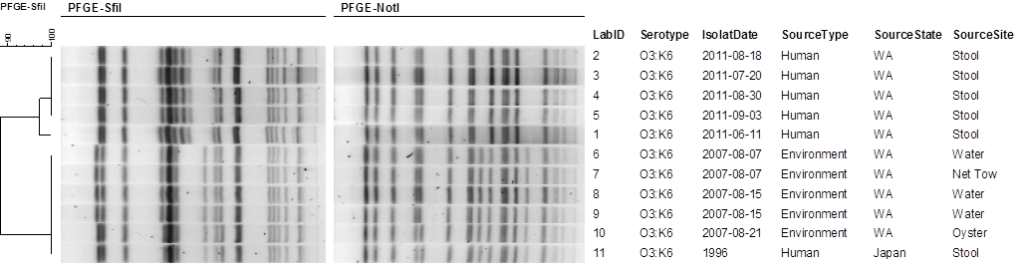
Pulsed-field gel electrophoresis (PFGE) patterns of 2011 clinical and 2007 environmental V. parahaemolyticus O3:K6 isolates
pandemic O3:K6
PFGE pattern shows some differences between clinical and environmental strains
Notes:
However there were some differences in the PFGE patterns.
Take home:
Strains with similar serotypes and or sequence type may be present in the environment. Changes in the environment (currently unknown) may alter the virulence of these isolates.
More than one typing method that could easily be used by public health labs would be necessary to track the genotype of emerging infectious isolates.

Slide 9
Summary
Potentially virulent V. parahaemolyticus strains may be endemic in the environment but cause illnesses under certain (currently undefined) conditions
Other environments could also harbor potentially virulent V. parahaemolyticus strains of previously undetected sequence types, serotypes and genotypes regardless of geographic location
Standardized surveillance methods (using similar typing methods) will be helpful in the tracking spread and evolution of potentially virulent genotypes/serotypes

Slide 10
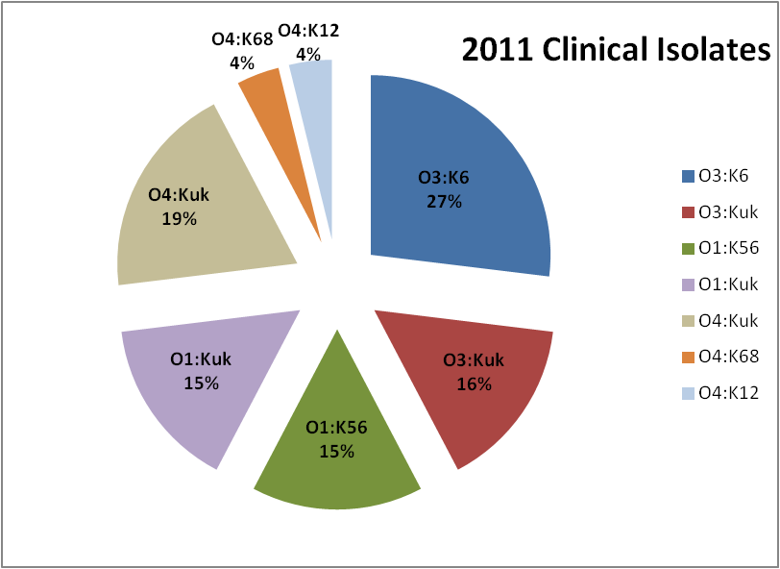
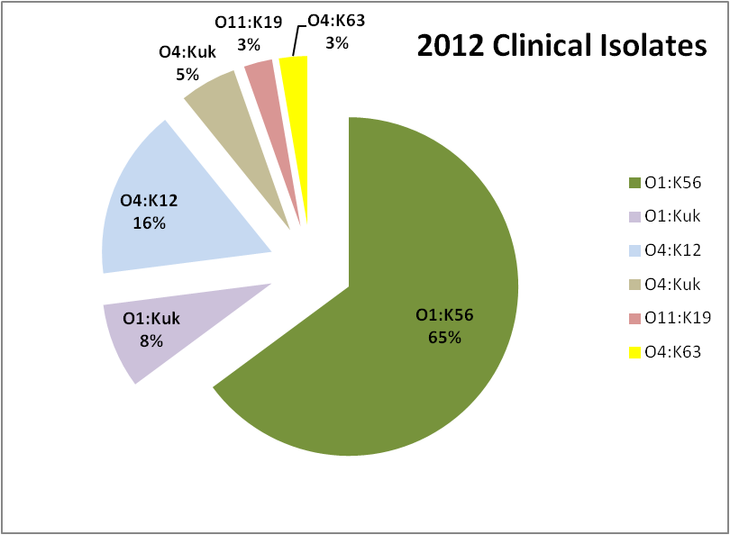
  Example of shifts in prevalence of clinical serotypes
Total n=26
Total n=41
45% increase in 2012 isolates associated with serotype O1:K56 compared to 2011
Sustained clinical surveillance is important to understand trends and to correlate back to what we see in the environment
Funding and resources is inconsistent (most requirements is focused on confirming identifications)

Slide 11
  Virulence markers in clinical isolates
Year | Total Isolates | trh+ only | tdh+ only | trh+ and tdh+ | No virulence markers
2014 | 51 | 15 (29%) | 2 (4%) | 34 (67%) | 0
2015 | 50 | 20 (40%) | 0 (0%) | 30 (60%) | 0
All isolates confirmed as Vibrio parahaemolyticus using a molecular assay in the Washington State Special Bacteriology Laboratory.
All isolates tested positive for tlh using the real-time pcr assay in the Washington State Food & Shellfish Bacteriology Laboratory.

Slide 12
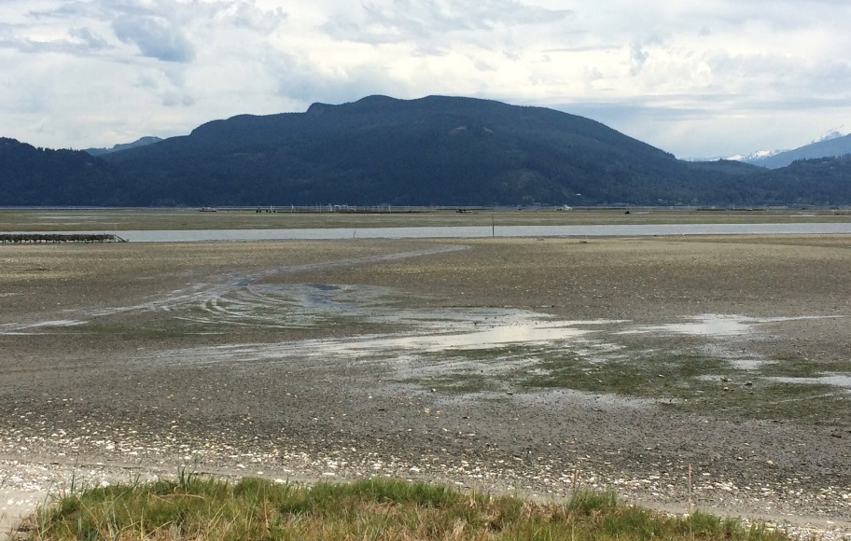
Environmental conditions associated with elevated Vp concentrations in Washington

Slide 13
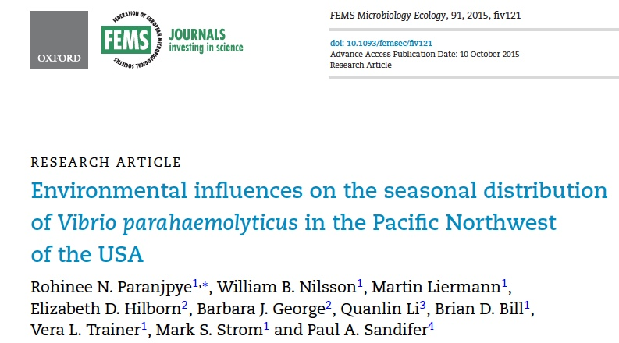
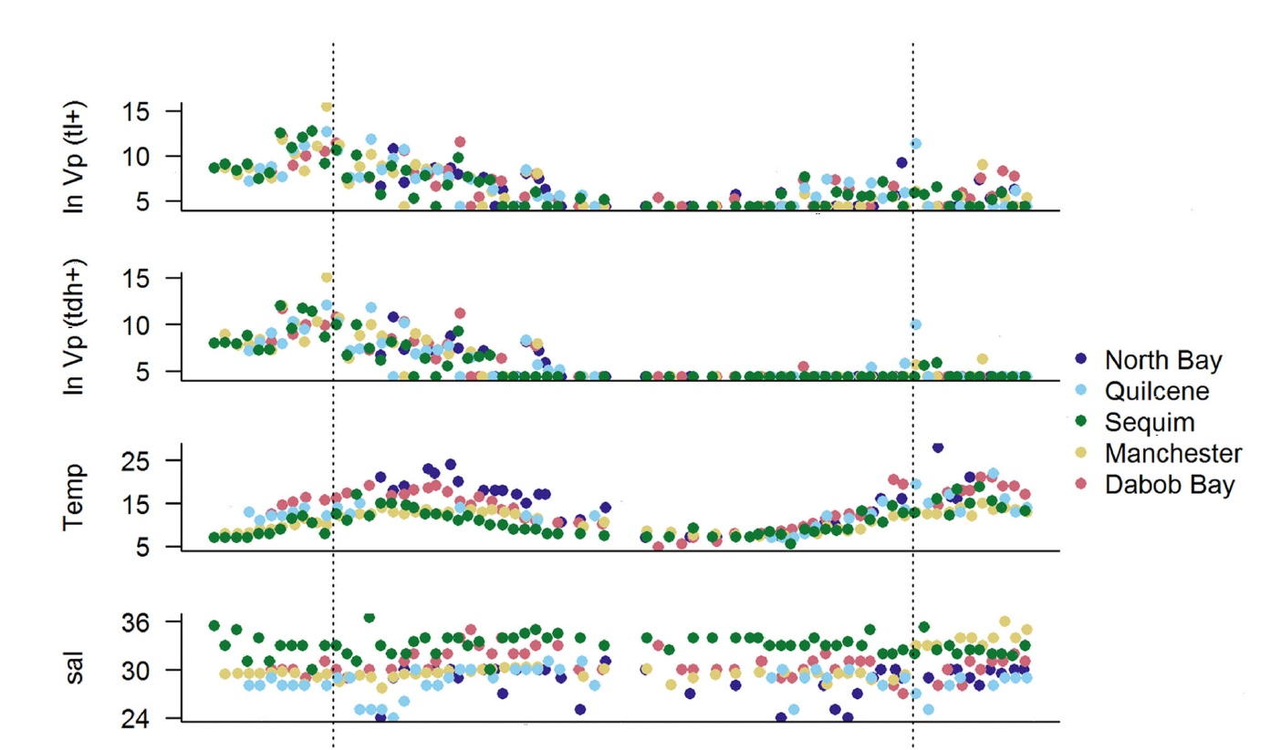
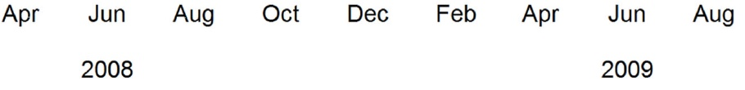
Environmental influences
2008-2009 study… suggest a strong seasonal trend
Notes:
5 sites in WA monitored year round for 2 years.
The variability in V. parahaemolyticus density was explained predominantly by strong seasonal trends where maximum densities occurred in June, two months prior to the highest seasonal water temperature.
In spite of large geographic differences in temperature, salinity and nutrients, there was little evidence of corresponding differences in V. parahaemolyticus density.
No evident relationship between V. parahaemolyticus and phytoplankton
Silicate was the only nutrient significantly associated with V. parahaemolyticus density (negative correlation)

Slide 14
Other findings…
Temperature by itself is not a strong predictor of Vp densities in water
Highest water temperature noted in June, 2 months prior to highest Vp levels in water
Salinity, other nutrients (except silicate) and phytoplankton populations, did not show any effect on Vp densities
  Silicate negatively correlated to Vp concentrations
No difference in Vp levels between 5 sites studied
Need to focus on other regional differences in the PNW

Slide 15
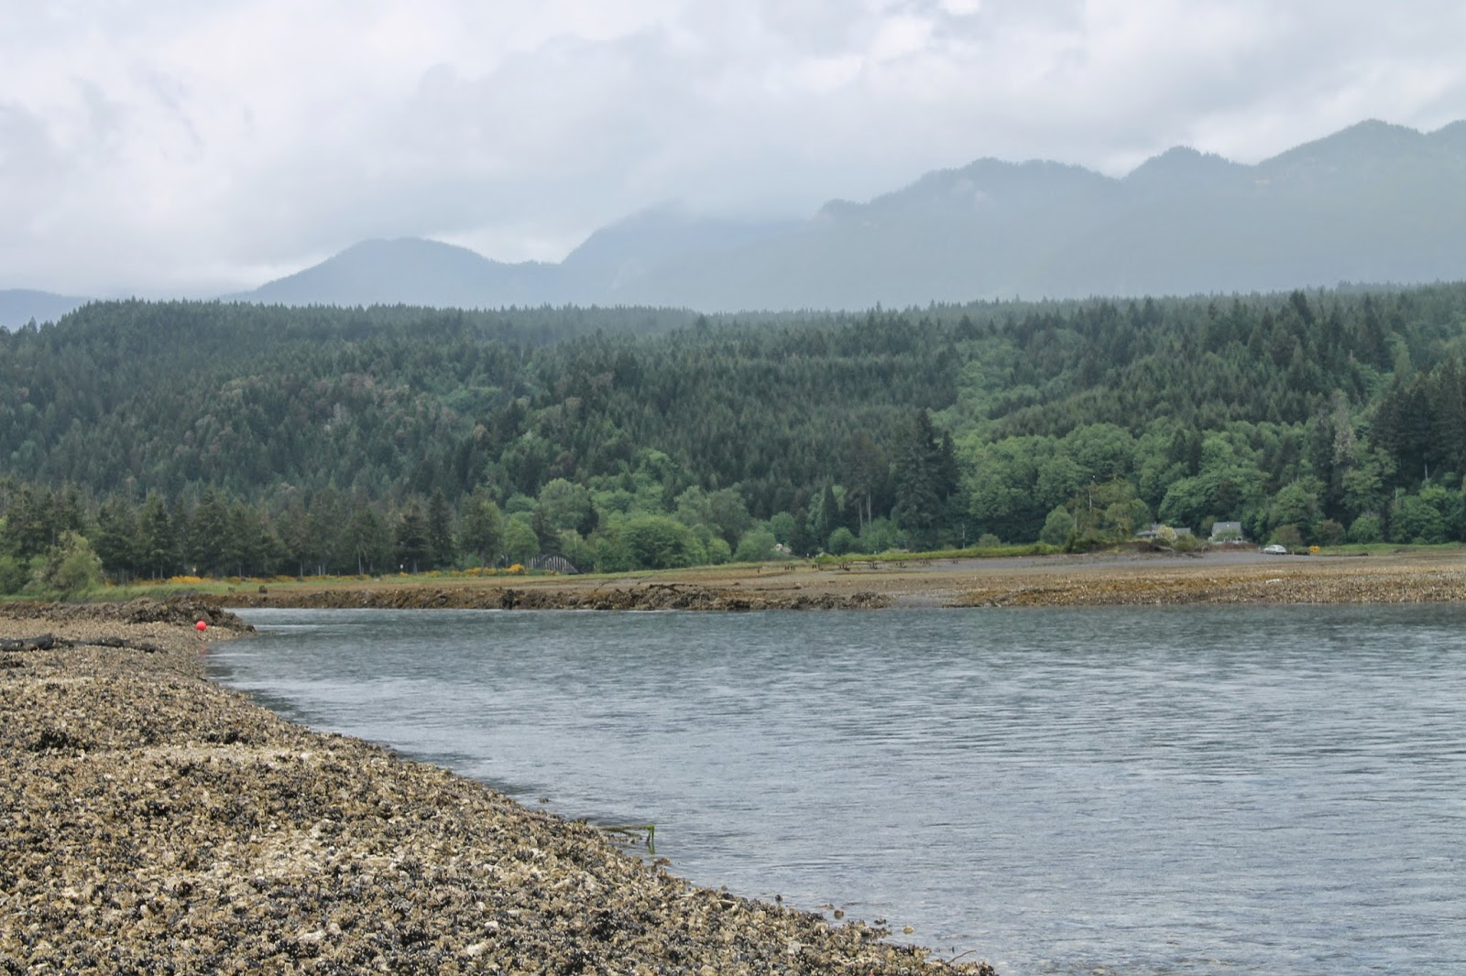
Vp forecasting challenges-regional differences
  Environmental factors that influence Vp
  Shellfish growing sites – intertidal
  Strains that cause illness
  Currently no hydrodynamic model for intertidal regions
  State regulations on harvesting (based on historical illnesses)
  Species of shellfish – majority C.gigas
  Model in development based on differences in substrate incorporating modeled weather data
    Collaboration between NOS/NCOOS, NWFSC and WA DOH
Notes:
Collaborative effort underway between NOS/NCOOS, NWFSC and WDOH to develop a model to predict Vp concentrations in oysters based on type of substrate

Slide 16
Puget Sound Intertidal model
Compared Vp concentration in 3 different substrates (gravel, mud and mixed) within 3 growing areas
Incorporated modeled weather data from NAM*(temperature, wind speed, surface radiation)
Shellfish harvest could potentially be managed based on sediment type
2015-2016 study
* North American Mesoscale Forecast System
Notes:
Two years worth of data looks promising. We see differences in Vp concentrations based on type of substrate. Need additional data in subsequent years to validate findings. However the potential does exist to provide short term (days) forecasts to predict conditions where Vp levels may exceed the FDA 10,000MPN/g.

Slide 17
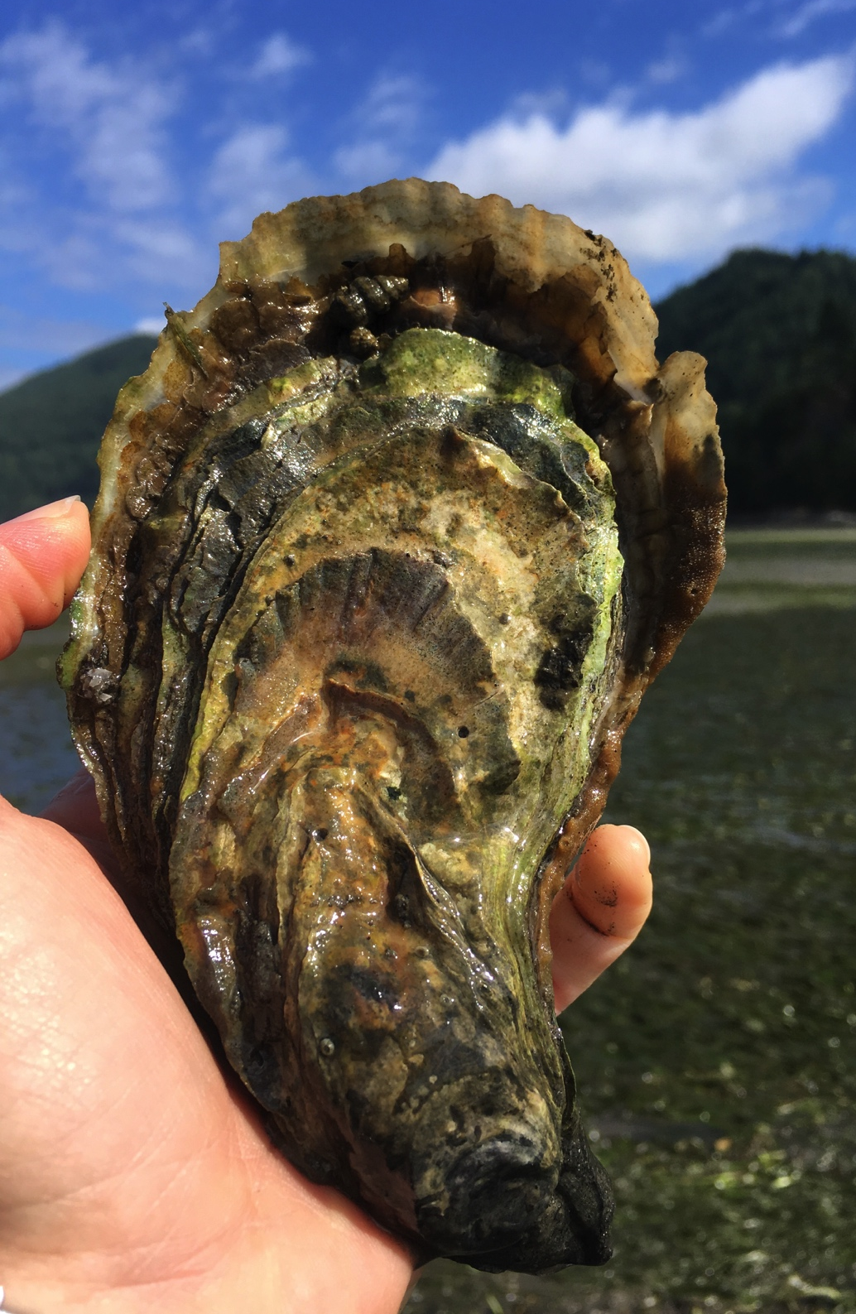
Washington’s Vp Management Strategies

Slide 18
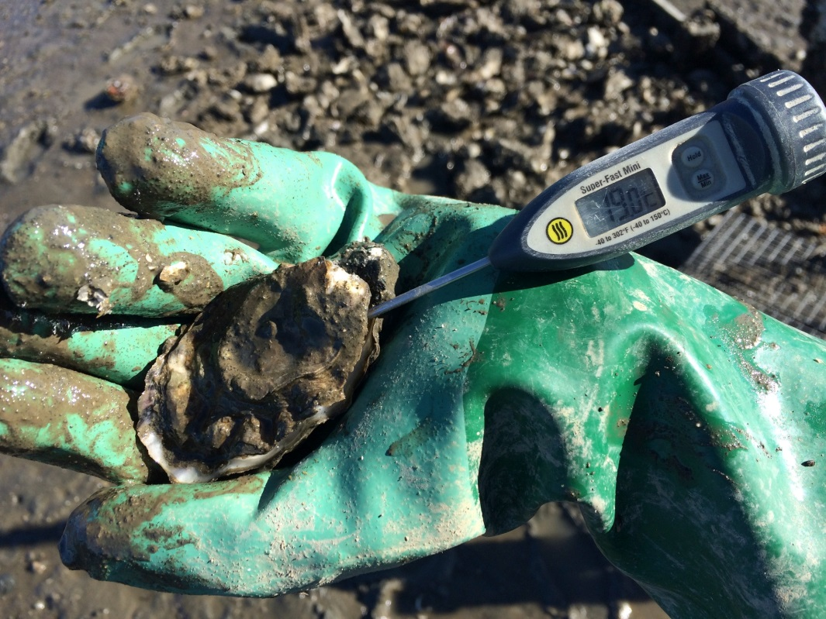
Key components of the Vp Control Plan in WA
Risk Categories
Single-source Vp cases
Air and harvest temperatures at time of harvest
May 1st to September 30th
  July and August
Time to internal
temperature of 50°F
Notes:
Single source: a laboratory-confirmed Vp-associated illness or illnesses with a common exposure that are reported to the department. The case must be:
Associated with commercially harvested shellstock; 2. Not involve documented postharvest abuse; and 3. Traced back to a single growing area.
Harvest to cooling: Adequately ice or place in a controlled environment with a temperature of 45°F (7.2°C) or less; and Reach and maintain an internal oyster tissue temperature of 50°F (10°C) or less

Slide 19
Intent of Control Plan Revision
Epi Curve
Closures
Number of Illnesses
Time
Closures
Number of Illnesses
Epi Curve
Time
Notes:
Prevent Vp illnesses associated with the consumption of commercially-harvested oysters
The controls missed the most risky period (July-Aug) and occur as the risk is declining (Aug-Sept)
WA has not revised the control plan since 2009, subsequent changes to the MO mean that our control plan needs updated to be in compliance with the national program. WA is also a leading state on Vp issues and this plan is innovative and prevention-based while the national requirements are largely reactionary.
Very collaborative effort -
Advisory committee list includes 47 individuals representing Northwest Indian Fisheries Commission, Point No Point Treaty Council, individual tribes, Pacific Coast Shellfish Growers Association, individual companies (small and large businesses, Coastal and Puget Sound, all license types), local health jurisdictions, Washington Department of Fish and Wildlife, the Food and Drug Administration, National Oceanographic and Atmospheric Administration, Sea Grant, Pacific Shellfish Institute
Nearly monthly meetings over a two-year period, met at off-site locations, developed and revised language as small groups to present to full committee
Subcommittees: Risk Assessment, Environmental Sampling, Landings Solutions (to aid in developing the implementation plan for collecting oyster production data)

Slide 20
Risk Category 1
Requirements | Time to Cooling
Except as noted below, the time of harvest to cooling requirement from June 1st to September 30th is: | 9 hours
When ambient air temperature at harvest is greater than 90°F, the time of harvest to cooling requirement is: | 7 hours
When harvest temperature is between 68°F and 70°F from July 1st to August 31st, the time of harvest to cooling requirement is: | 5 hours
Harvest Control: From July 1st to August 31st, harvest is not allowed for 24 hours when harvest temperature is above 70°F.

Slide 21
Risk Category 3
Requirements | Time to Cooling
Except as noted below, the time of harvest to cooling requirement from May 1st to September 30th is: | 5 hours
When ambient air temperature at harvest is greater than 80°F, the time of harvest to cooling requirement is: | 3 hours
When harvest temperature is between 64°F and 66°F from July 1st to August 31st, the time of harvest to cooling requirement is: | 1 hour
Harvest Control: From July 1st to August 31st, harvest is not allowed for 24-hours when harvest temperature is above 66°F.

Slide 22
Total Vp Illnesses from Oyster Consumption
(Attributed to Washington Growing Areas by Year)
* data as of 9/4/17

Slide 23
Oysters harvested from May-Sep 2015
Notes:
Integrated details on reporting into WAC: by month May-Sept, by species, by size class (pacifics) and only shellstock oysters (no shucked/PHP)
Reporting by paper or online, online system went live Oct 1. Reporting required by Dec. 31 or cannot harvest shellstock oysters May-Sept

Slide 24
2015 and 2016 Harvest Totals by Region
*as of 6/30/17

Slide 25
Overall Regional Average Risk Comparison (2012-2016)
1 in 850,000
1 in 900,000
1 in 4 million
1 in 18.5 million
*Regional average calculations include 0 risk growing areas
*As of 6/30/17
Notes:
Production is a good indicator of illnesses because illness count and risk not a 1 to 1 relationship
Ex. Area produces 5 o’s 1 illness, area produces 50 o’s 5 illness= 1/5 vs. 1/10. Creates an outlier situation from low production growing areas. Bump up the average risk significantly, when any illness comes from low production growing areas, where otherwise expected to be zero.

Slide 26
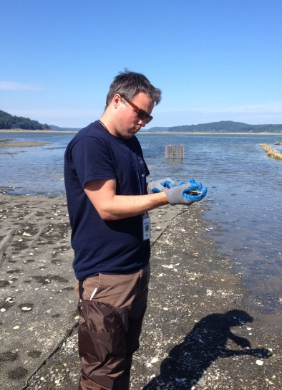
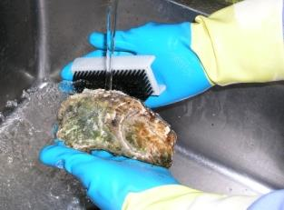
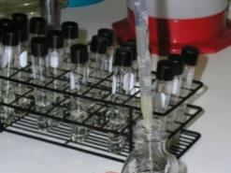
Environmental Monitoring
Sampling oysters:
  Water, air and tissue temperature
  Salinity
Public Health Lab tests oysters for:
  tlh (species marker)
  tdh (pathogenicity marker)
  trh (pathogenicity marker)
Temperature dataloggers

Slide 27
Environmental Sampling Results
 | 2015 |  | 2016 | 2017
Samples taken |  | 271 | 248 | 147*
Sampling locations |  | 22 | 19 | 12
Sampling dates |  | 6/2/15 - 9/29/15 | 6/4/16- 9/28/16 | 6/6/17-8/31/17*
tlh |  | <0.30 - >110,000 MPN/g | <0.30 - >110,000 MPN/g | <0.30 - >110,000 MPN/g
tdh |  | <0.03 – 430 MPN/g | <0.3 - 230 MPN/g | <0.3 - 430 MPN/g
trh |  | <0.03 - 46,000 MPN/g | <0.3 - 7,500 MPN/g | <0.3 – 110,000 MPN/g
Salinity |  | 4.0 - 35 ppt (Avg: 27.5) | 4.2-30.8 ppt (Avg: 25.5 ppt) | 5-32 ppt
Ambient air temperature |  | 42- 95⁰F (Avg: 68.3⁰F) | 49.5-88.9⁰F (Avg: 64.7⁰F) | 51.8-83.3⁰F
Surface water temperature |  | 53- 82⁰F (Avg: 67.3⁰F) | 55.9-80.4⁰F (Avg: 66.0⁰F) | 56.1-95.7⁰F
Shore water temperature |  | 54 - 87 ⁰F | 55.2-81.1⁰F (Avg: 67.1⁰F) | 57.2-88.4⁰F
Oyster tissue temperature |  | 47 - 98 ⁰F (Avg: 72.7⁰F) | 49.5-101.1⁰F (Avg: 70.0⁰F) | 53.6-96.1⁰F
27

Slide 28
Notes:
Lots of variability between tlh, tdh and trh from week to week and their relative values
High levels not necessarily associated with illnesses

Slide 29
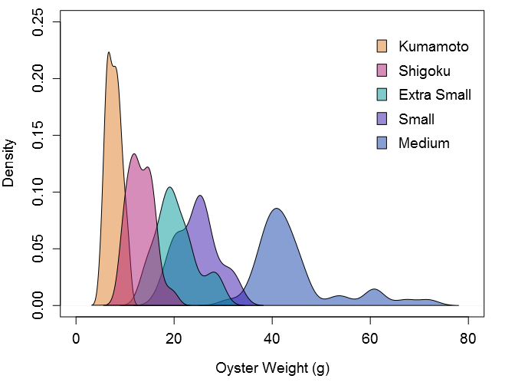
Oyster size and consumption patterns
Cheney, J. unpublished data.
Notes:
Updating and localizing the FDA Vp risk model
Developing it in R, free software that allows high degree of user input and flexibility in design, very adaptable for another state/region to use
Focus the model on WA harvest methods and be able to compare risk within the state (so between growing areas)
Updated oyster serving size with oysters weights of specialty and pacific oysters by size
Conducted consumer survey, final report being prepared, but the majority of respondents stated they ate 6 oysters/sitting (avg. 7.3)
Still need work on heat transfer: collected data this summer with NOAA comparing Vp levels and temps for oysters on muddy vs. gravelly sites
Make it something the industry can use

Slide 30
Thank you!
Clara Hard
Department of Health
Washington State
clara.hard@doh.wa.gov
360-236-3314

