Slide 1
Vp Risk Assessment and Calculator Development
John Bowers, FDA/CFSAN
ISSC Vp Workshop, Baltimore MD
September 6-7, 2017

Slide 2
Overview
Risk Assessment and Risk Calculator Development
Key Assumptions and limitations
Validation / Skill Assessment
Recent modifications / updates of the calculator

Slide 3
Timeline of 2005 VP QRA
Public Meeting/NACMCF
Public Meeting/NACMCF
Use Model for RM Options
Initiate Risk Assessment
Stakeholder Input
Gather Data
Develop Model
Review
Prepare Report
Public Comments
New Data
Model Techniques
Review
Prepare Report
Issue Draft Report
Issue Revised Report
Public Meeting
Public Meeting
Outbreaks
1997
1998
1999
2000
2001
2002
2003
2004
2005
Notes:
This diagram shows the timeline for the conduct of the VP RA
We held several public meetings to involved the general public and other stakeholders -- including many ISSC members throughout the process as Dr. Brackett mentioned, including one after th edraft risk assessmnet was issued.

Slide 4
Vp Risk Assessment (2005)
Hazard Identification
  Pathogenic Vp in raw oysters
Hazard Characterization/Dose-Response
  Based on CDC Illness surveillance observations
Exposure Assessment
  By region / season / harvest type categories
Risk Characterization
  Sensitivity Analysis
  Validation
  What-If Scenarios and Effect of Mitigations
Notes:
The RA was conducted in accordance with the 1999 Joint FAO/WHO Expert Consultation framework for conducting RA’s. The 4 steps in this RA are defined as:...
Hazard Identification
Description of Pathogenic Vp in raw oysters, including physiology, virulence, epidemiology
Exposure Assessment
likelihood of ingesting Vp by eating raw oysters harboring the organism
Hazard Characterization/Dose-Response
Relationship of the levels of Vp ingested with the frequency and magnitude of illness
Risk Characterization
Integration of hazard characterization and exposure assessment to determine the risk of illness and uncertainty - An important part of this step is determining the uncertainties associated with these predicted risk estimates distinguishing, to the extent possible, uncertainty from the inherent variation that occurs in any biological and environmental system.
the baseline model was used to develop “what-if” scenarios to evaluate the likely impact of potential intervention strategies on the exposure to pathogenic V. parahaemolyticus from consumption of raw oysters.

Slide 5
Vp Calculator (2007)
Introduced as part of an ISSC proposal which proposed use of calculator as a mandatory evaluation element in the NSSP MO
  rejected as originally proposed
  adopted for use at the discretion of SSCA
A surrogate calculation embedded in Excel worksheet
  reproduces selected input-output of Vp QRA
  season/region “downscaled” to month/state
  mean exposure and risk/serving determined by mean water/air temperatures and max time-to-refrigeration
  Max cooldown time fixed at 10h

Slide 6
Key Assumptions
Total Vp levels at-harvest
  determined by water temperature alone
  two relationships; one for the PNW and one for all other regions
Total Vp growth post-harvest
  During harvest: oyster temperature = air temperature (rapid equilibration, no evaporative cooling, no radiative heating)
  During intertidal exposure: oyster temperature > air temperature (radiative heating)

Slide 7
Key Assumptions
tdh⁺ strains regarded as pathogenic Vp
All tdh⁺ strains equally virulent
Prevalence of tdh⁺ strains:
  approx 2.3% of total Vp in PNW and 0.2% in other regions
Growth and survival of pathogenic Vp is the same as total Vp
Growth rate determined by temperature alone
No variability in growth rate at any given temperature
  estimated growth rate in oysters = ¼ the growth rate of that in broth culture at all temperatures (Miles et al vs Gooch et al)
Fixed die-off rate & distribution of storage times
No lag time to growth of Vp post-harvest

Slide 8
Key Assumptions
  Illness underreporting multiplier
    20:1 estimate (Mead et al 1999)
    now estimated at > 150:1 (Scallan et al 2011)
  Servings determined by NMFS landings
    Average serving size of 12 oysters (approx 200g)
    Raw consumption = 50% of landings
    no seasonal or regional variation in raw consumption percentage

Slide 9
Validation / Skill Assessment
  Vp Risk Assessment (2005)
    predictions of region/season exposures (Vp/g at retail) - good
    predicted total # of illnesses - can’t be validated
    prediction of seasonal distribution of illness - good/fair
    predictions of regional distribution of illness - poor
  Vp calculator (2007)
    no validation was conducted
  Individual components of QRA
    Growth rate model
    Total Vp at-harvest versus water temperature
  Predicted Effect of time-temperature controls

Slide 10
Validation / Skill Assessment
6
/g
4
V. parahaemolyticus
2
10
0
ISSC/FDA retail data
log
model predictions (based on average temperatures)
model predictions (based on 1998 temperatures)
-2
Winter
Spring
Summer
Fall
Gulf Coast Harvest

Slide 11
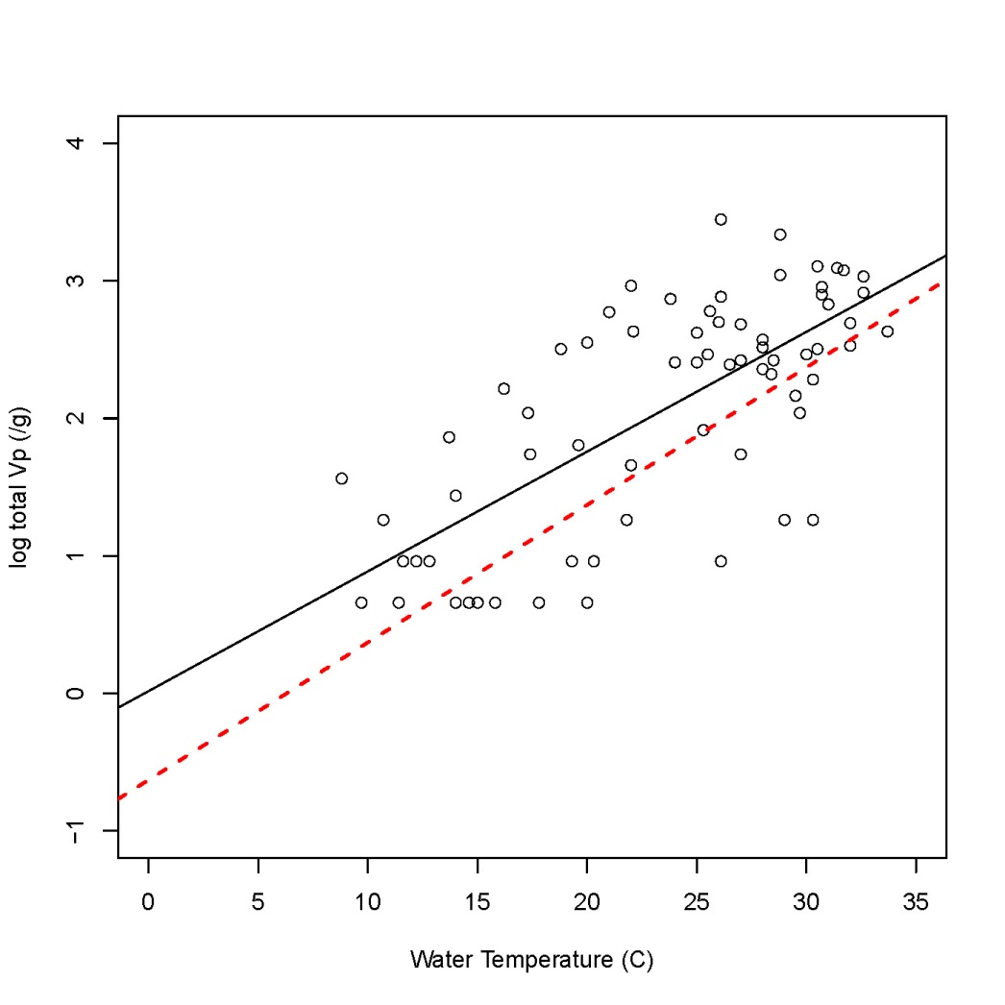
Validation / Skill Assessment
Johnson et al 2010
VPQRA: red dashed lines
MS observations: black circles/line
Observed data slightly higher than VPQRA
Possible artifacts
  VPQRA: No MS data
  9/70 non-detects plotted at LOD
  Direct plating DNA probe
Notes:
This graph shows data from Johnson et al study of the relationship between Vp levels in in MS oysters and water temperature (black dots and line) relative to VPQRA predictions (red dashed line. MS data suggests a similar relationship between Vp levels and water temperature as model prediction but with slightly higher Vp levels. The slope of the line may be influenced by using the LOD for non-detect samples.

Slide 12
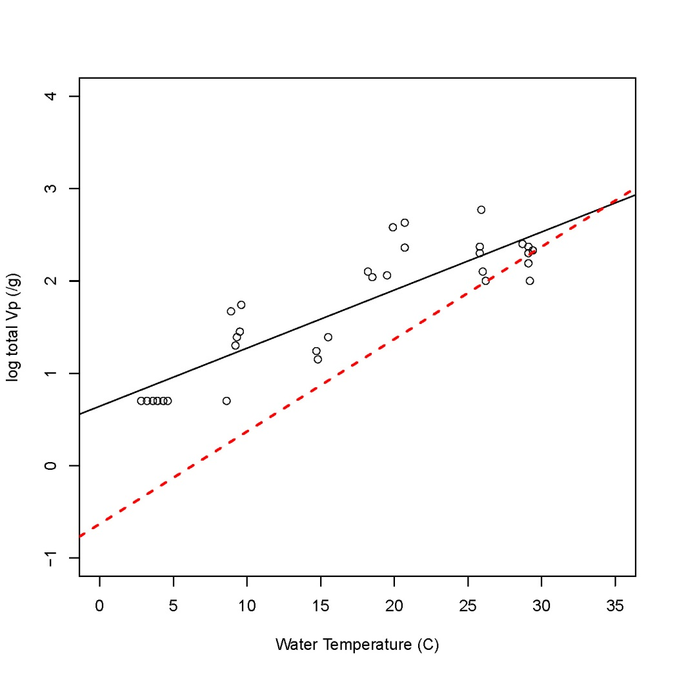
Validation / Skill Assessment
Parveen et al 2009
VPQRA: Red dashed line
MD Observations: black circles/line
Observed values less influenced by water temperature and greater than VPQRA especially at lower temperatures
Issues/artifacts
  Non-detect plotted at LOD
  MD data not in VPQRA

Slide 13
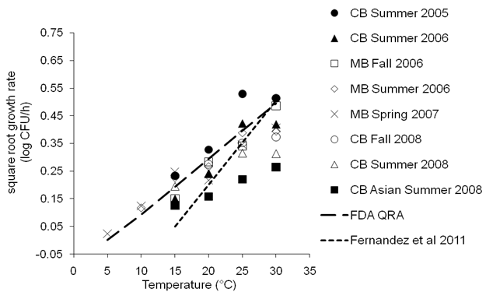
Validation / Skill Assessment
Parveen et al., International J of Food Microbiology 161:1-6 (2013)

Slide 14
Predicted Effectiveness of Rapid Cooling
100%
80%
60%
Percentage Reduction in Mean Risk
per Serving
40%
20%
Gulf (all) summer (rapid (1 hr) cooldown)
Gulf (all) summer (conventional cooldown)
0%
0
1
2
3
4
5
Maximum Time until Refrigeration
Notes:
This graph shows the predicted reduction in illness associated with a reduction in the time from harvest to the initiation of chilling for summer harvest of Gulf Coast oysters with cooling begun from one to four hours after harvest. The top dotted line represents cooling with ice, and the bottom line cooling under refrigeration. Depending upon the specifics of the scenario, the predicted reduction in Vp illness from summer harvest of Gulf Coast oysters ranges from 46% to 97%. As you can see there is a much greater reduction in illness if there is rapid cooling using ice. It is quite probable that predicted reductions for other regions and seasons where the climate is cooler, would be less dramatic.

Slide 15
Illness History in Connecticut:
2009 to 2014 Illness Summary
Year | Confirmed CT Cases | Multi-State Including CT
2009 | 1 | 2
2010 | 1 | 2
2011 | 1 | 2
2012 | 1* | 3
2013 | 23** | 11
2014 | 1 | 2
*2012 Closure of Westport/Norwalk growing area from 7/15/12 through 9/19/12
** 2013 Closure of Westport/Norwalk growing area from 8/2/13 through 9/16/13

Slide 16
Modifications / Updates
Ongoing Regional Risk Assessment Efforts by SSCAs
  Connecticut, Washington, New Jersey, Massachusetts
Standing VARB request (from WA) to modify existing Vp calculator
  Remove the fixed 10hr cooldown time
Status of Vp calculator
  Reworking Excel spreadsheet approach of limited value
  Propose to harmonize with approach developed for Norovirus QRA and place calculations behind a webpage

Slide 17
New Jersey Production 2010-2016
 | 2010 | 2011 | 2012 | 2013 | 2014 | 2015 | 2016
April | 11579 | 7405 | 7626 | 6520 | 8041 | 8041 | 12183
May | 12102 | 13100 | 11694 | 14414 | 13285 | 13285 | 19494
June | 10548 | 11731 | 13411 | 16568 | 18169 | 18169 | 19408
July | 13203 | 13848 | 12275 | 15229 | 13805 | 13805 | 16597
August | 10661 | 11614 | 11866 | 11149 | 11183 | 11183 | 13433
September | 9159 | 648 | 9223 | 12096 | 12425 | 12425 | 9394
October | 4210 | 18084 | 8487 | 6003 | 6273 | 6273 | 7087
November | 2913 | 16935 | 3557 | 2415 | 4249 | 4249 | 2499
December | 0 | 1580 | 0 | 0 | 0 | 0 | 0
Annual Total | 74375 | 94945 | 78139 | 84394 | 87430 | 87430 | 100095

Slide 18
Massachusetts Production 2012-2016
Month | 2012 | 2013 | 2014 | 2015 | 2016
1 | 1502330 | 1654700 | 1768291.32 | 2374597 | 3237662
2 | 1654208 | 1592420 | 2199489.37 | 1762849 | 3034108
3 | 1689065 | 1706207 | 2595998.59 | 2954711 | 3319427
4 | 1575658 | 1737671 | 3050643.03 | 3978224 | 3623669
5 | 1623283 | 1657438 | 2909909.85 | 4014422 | 3507344
6 | 1762985 | 1767876 | 3049818.9 | 5195105 | 4441023
7 | 2401271 | 2577549 | 3628718.97 | 5546894 | 10788841
8 | 2394467 | 3358508 | 3693084.66 | 6333709 | 5650556
9 | 2081858 | 2273978 | 3076914.69 | 4511461 | 3967782
10 | 1980795 | 2180557 | 2943481.31 | 3257942 | 2473442
11 | 1905106 | 1879701 | 2256376.75 | 4039888 | 3107945
12 | 2277635 | 2664476 | 2805114.7 | 4564960 | 3687932

Slide 19
MA Quahog Fishery, Bushels Landed by Month, 2005-2016
MONTH | 2005 | 2006 | 2007 | 2008 | 2009 | 2010 | 2011 | 2012 | 2013 | 2014 | 2015 | 2016
JAN | 2,109 | 5,413 | 4,724 | 4,931 | 3,825 | 5,034 | 3,433 | 2,830 | 3,522 | 2,044 | 1,740 | 2,194
FEB | 2,322 | 3,894 | 3,360 | 4,611 | 4,697 | 3,625 | 3,285 | 3,611 | 2,661 | 2,736 | 320 | 2,396
MAR | 2,545 | 5,448 | 5,236 | 5,675 | 5,742 | 5,392 | 4,928 | 5,133 | 3,310 | 4,304 | 2,605 | 3,977
APR | 3,374 | 6,206 | 5,300 | 7,194 | 7,684 | 6,992 | 4,382 | 5,953 | 4,635 | 4,856 | 5,628 | 3,839
MAY | 4,658 | 7,812 | 9,193 | 8,118 | 9,006 | 9,054 | 6,449 | 6,259 | 7,244 | 7,691 | 5,426 | 6,084
JUN | 1,672 | 8,358 | 10,324 | 10,758 | 9,309 | 8,947 | 6,754 | 6,329 | 8,060 | 8,016 | 7,982 | 8,006
JUL | 8,147 | 10,746 | 12,118 | 12,304 | 8,611 | 9,197 | 7,342 | 6,705 | 8,368 | 7,394 | 9,833 | 8,081
AUG | 7,499 | 11,696 | 12,678 | 12,029 | 9,993 | 9,153 | 6,701 | 7,182 | 7,416 | 8,219 | 8,042 | 8,021
SEP | 5,003 | 8,527 | 10,066 | 8,369 | 8,613 | 7,497 | 6,451 | 6,017 | 5,546 | 6,106 | 7,791 | 6,865
OCT | 3,465 | 6,636 | 7,687 | 6,689 | 5,560 | 5,969 | 4,672 | 4,926 | 4,889 | 7,229 | 5,099 | 2,479
NOV | 4,045 | 6,258 | 6,359 | 4,702 | 5,581 | 4,949 | 4,682 | 4,454 | 5,452 | 5,132 | 5,225 | 3,970
DEC | 4,072 | 6,923 | 5,941 | 6,241 | 4,601 | 4,334 | 4,533 | 3,207 | 3,726 | 3,481 | 3,965 | 3,930
SOURCE:SAFIS Dealer Database
MA Oyster Fishery, Pieces Landed by Month, 2005-2016
MONTH | 2005 | 2006 | 2007 | 2008 | 2009 | 2010 | 2011 | 2012 | 2013 | 2014 | 2015 | 2016
JAN | 291,417 | 1,018,495 | 714,505 | 699,698 | 710,680 | 1,300,335 | 1,163,303 | 1,480,457 | 1,703,777 | 1,735,094 | 2,375,742 | 2,607,965
FEB | 488,051 | 710,485 | 495,384 | 755,014 | 884,968 | 1,220,592 | 1,099,476 | 1,651,791 | 1,634,977 | 2,164,262 | 1,763,700 | 2,915,332
MAR | 784,882 | 1,026,461 | 867,533 | 780,805 | 1,033,992 | 1,251,019 | 1,321,888 | 1,796,028 | 1,758,980 | 2,654,586 | 2,956,137 | 3,321,029
APR | 908,319 | 1,010,144 | 776,277 | 836,699 | 1,143,332 | 1,366,696 | 1,054,645 | 1,553,465 | 1,813,107 | 2,955,605 | 3,378,944 | 3,174,518
MAY | 603,587 | 796,996 | 885,758 | 849,502 | 1,077,924 | 1,300,957 | 1,033,466 | 1,591,207 | 1,762,288 | 2,740,204 | 3,729,949 | 2,967,958
JUN | 138,643 | 731,460 | 798,455 | 925,675 | 1,179,838 | 1,405,929 | 1,497,117 | 1,769,274 | 1,845,263 | 2,894,821 | 3,843,232 | 3,451,188
JUL | 550,968 | 906,871 | 995,099 | 1,236,213 | 1,399,854 | 1,535,855 | 2,258,205 | 2,428,258 | 2,634,837 | 3,528,190 | 4,196,872 | 4,039,765
AUG | 736,702 | 1,367,082 | 1,045,246 | 1,159,362 | 1,374,699 | 1,611,878 | 2,482,446 | 2,397,085 | 3,150,795 | 3,634,685 | 4,412,928 | 4,907,288
SEP | 683,908 | 2,131,232 | 899,630 | 1,024,377 | 1,187,912 | 1,397,590 | 2,005,675 | 2,049,981 | 2,212,270 | 3,055,010 | 3,671,959 | 3,819,396
OCT | 810,836 | 1,534,621 | 962,947 | 910,876 | 1,163,616 | 1,441,878 | 1,644,069 | 1,973,819 | 2,187,537 | 3,065,473 | 3,259,514 | 2,474,635
NOV | 616,598 | 2,018,431 | 800,092 | 863,270 | 1,050,260 | 1,308,678 | 1,555,244 | 1,924,925 | 1,949,446 | 2,570,894 | 2,959,679 | 3,109,444
DEC | 721,220 | 1,797,623 | 904,651 | 1,058,959 | 1,308,127 | 1,472,686 | 1,883,002 | 2,166,326 | 2,654,130 | 3,504,336 | 3,725,484 | 3,689,711
SOURCE:SAFIS Dealer Database

