Slide 1
Investigation of Vibrio parahaemolyticus Infections in Washington State
Laurie Stewart MS
Foodborne Disease Epidemiologist
Washington State Department of Health
September 6, 2017
Interstate Shellfish Sanitation Conference
National Vibrio parahaemolyticus Workshop

Slide 2
Questions:
How is the illness reported to you?
Who and how the illness is investigated?
What other parties are advised when you receive notification of illness?
What roles do other parties play when illnesses are reported?
What are the notification time lines for V.p. in your State?
What determines the timeliness of COVIS form submission to CDC?

Slide 3
How are illnesses reported to Public Health in Washington State?
Health care providers and clinical laboratories are required to report Vibrio infections to the local health jurisdiction (LHJ) where the case resides
LHJs investigate cases and enter the electronic disease management system where it becomes visible to Washington State Department of Health Communicable Disease Epidemiology (CD-EPI) and Shellfish Program staff
Laboratories are required to submit isolates or specimens to the Washington State Public Health Laboratory
Notes:
V. parahaemolyticus 68 case in 2015 and 57 in 2016
V. vulnificus 1 fish related case in 2016
V. Cholerae Last case of cholera was in 2002 in traveler to Phillippines
Other enterics

Slide 4

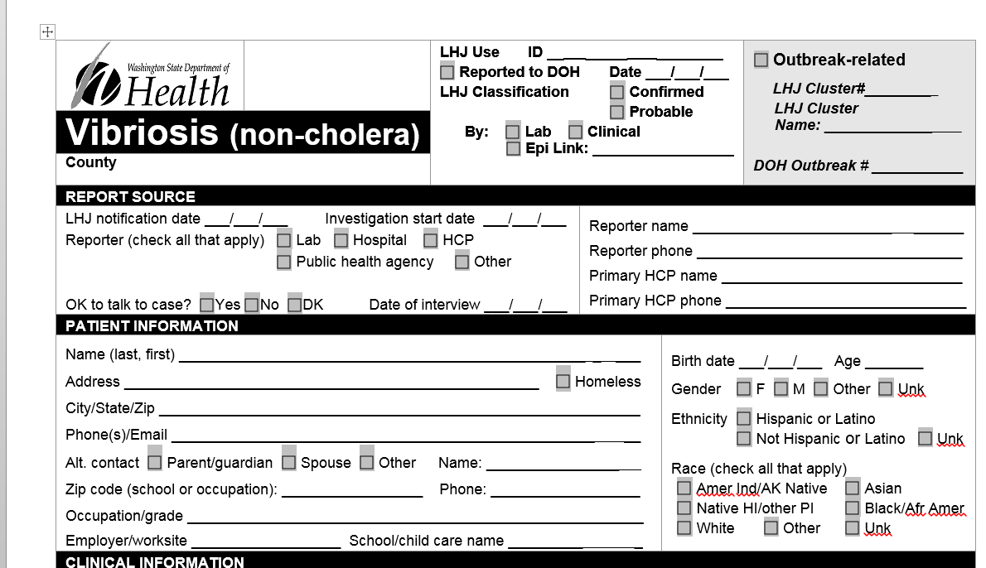
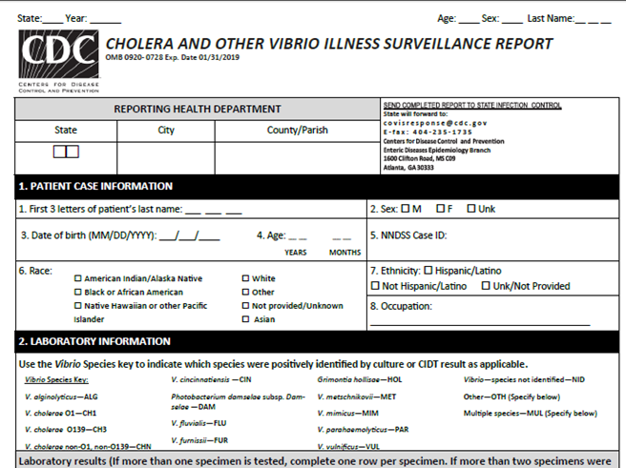
How are Vibriosis Cases Investigated? Who Investigates?
Local health jurisdictions (LHJs) interview vibriosis cases using a standardized Washington State form and the COVIS form

Slide 5
How are Vibriosis Cases Investigated? Who Investigates? Part 2
LHJs are advised to elicit detailed shellfish consumption data by:
  Look up restaurant menu online during interview
  Clarify from which menu shellfish were ordered (happy hour, dinner menu, special oyster list, etc)
  Specific name and type of dish: oyster shooters, oyster sampler, oyster ordered invidually
  Were oysters listed on receipt? Did they take a photo?

Slide 6
What other parties are advised when you receive notification of illness?
If the case reported consuming shellfish purchased from a retail facility:
  Environmental Health (EH) staff in the LHJ where the shellfish were purchased visit the retail facility to collect shellfish tags and evaluate whether there were any shellfish handling errors
  Tags are emailed or faxed to the Washington DOH Shellfish Program
Notes:
Norovirus not notifiable
Hepatitis A: 26 cases in 2015 (29 to 45 a year mostly international exposure). Steady decline since hep A vaccine added to child series (1999) era when there were >1000 cases per year

Slide 7
What roles do other parties play when illnesses are reported?
  If implicated shellfish was purchased in another state, the Washington State Shellfish Program requests shellfish tags from the other state and asks for them to be sent
Notes:
88 to 140 cases per year
139 in 2015
Mostly not shellfish related

Slide 8
What are the notification time lines in Washington State?
Health Care Providers and Labs are required to report cases within 24 hours of identification
LHJs are expected to attempt a case interview one work day of the report. It can take several days to a week to actually make contact with a case
If the case consumed shellfish, tags are typically collected within 1 to 2 work days of the time they are requested from Environmental Health. Intra-LHJ and Intra-State tag requests often take longer—up to several weeks or months
Once collected, tags are submitted to the Washington State Shellfish Program within 1 to 2 days
Notes:
PSP: Most years zero to 1 case. In 2009 there were nine cases with:
1 ill after eating mussels from Yukon Harbor near Bainbridge on August 14th
1,621µg PSP/100g tissue
1 ill after eating mussels from a floating buoy near Kingston September 5th
10,304µg PSP/100g tissue
7 ill after eating mussels from Discovery Bay on September 22nd
7,187µg PSP/100g tissue on 8/27/12
1 case 2015
Diarrhetic shellfish cluster in 2009

Slide 9
What determines the timeliness of COVIS form submission to CDC?
The amount of time it takes for the LHJ to complete the interview, request and obtain the tags, and submit the tags to the Washington State Shellfish program
The amount of time it takes clinical laboratory to submit the isolate or specimen to the Washington State Public Health Laboratory
The amount of time it takes the Washington State Public Health Laboratory to grow up and confirm Vibrio parahaemolyticus
The amount of time it takes the Washington State Shellfish program to complete the shellfish harvest information page on the COVIS form and submit to DOH CD-Epi
The amount of time it take DOH CD-Epi to pull together the COVIS form and tags from the LHJ, the harvest data from the Shellfish Program and the laboratory data from the public health lab
Notes:
PSP: Most years zero to 1 case. In 2009 there were nine cases with:
1 ill after eating mussels from Yukon Harbor near Bainbridge on August 14th
1,621µg PSP/100g tissue
1 ill after eating mussels from a floating buoy near Kingston September 5th
10,304µg PSP/100g tissue
7 ill after eating mussels from Discovery Bay on September 22nd
7,187µg PSP/100g tissue on 8/27/12
1 case 2015
Diarrhetic shellfish cluster in 2009

Slide 10
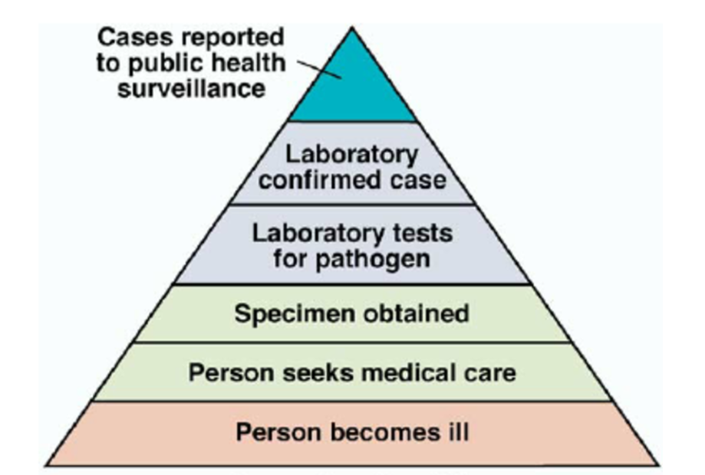
Actual Burden of Foodborne Illness is Higher than Reported Cases

