Slide 1


Environmental patterns for Vibrio parahaemolyticus
Dr. Rachel T. Noble,
Dr. Brett A. Froelich,
and Kelsey Jesser,
UNC Chapel Hill Institute of Marine Sciences

Slide 2

Southeast
Most data limited to NC isolates, water samples, and oyster meats
Temperature salinity matrices
Culture data
Patterns for Vp from bioinformatics analyses of 16SrDNA and hsp60
CA: Collaboration with SCCWRP, J. Craig Venter Institute and Scripps Institute of Oceanography for expanding work in southern California. Showing some brand new data.

Slide 3
Decision Matrices
Vibrio parahameolyticus in water (CFU/ml)
Vibrio parahaemolyticus in oysters (CFU/g)
Notes:
Three years of data collection in eastern North Carolina wild oyster reefs
This and other information from specific locations clearly shows that the population of Vp that resides within oysters can be very different from the Vp that is measured in the water
At least in the case of the majority of these locations, Vp confirmation was complete but only a small subset of the population was trh or tdh+

Slide 4
Vp in oysters by temp/date
Vp in water by temp/date
Total Vibrio in oysters by temp/date
Total Vibrio in water by temp/date

Slide 5
NC Patterns in VP at 5 sites compiled

Slide 6
Wild vs. Farmed Oysters

Slide 7
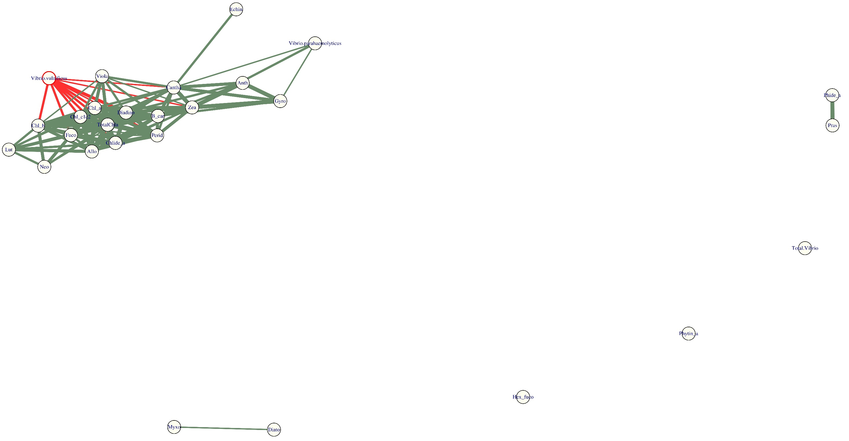
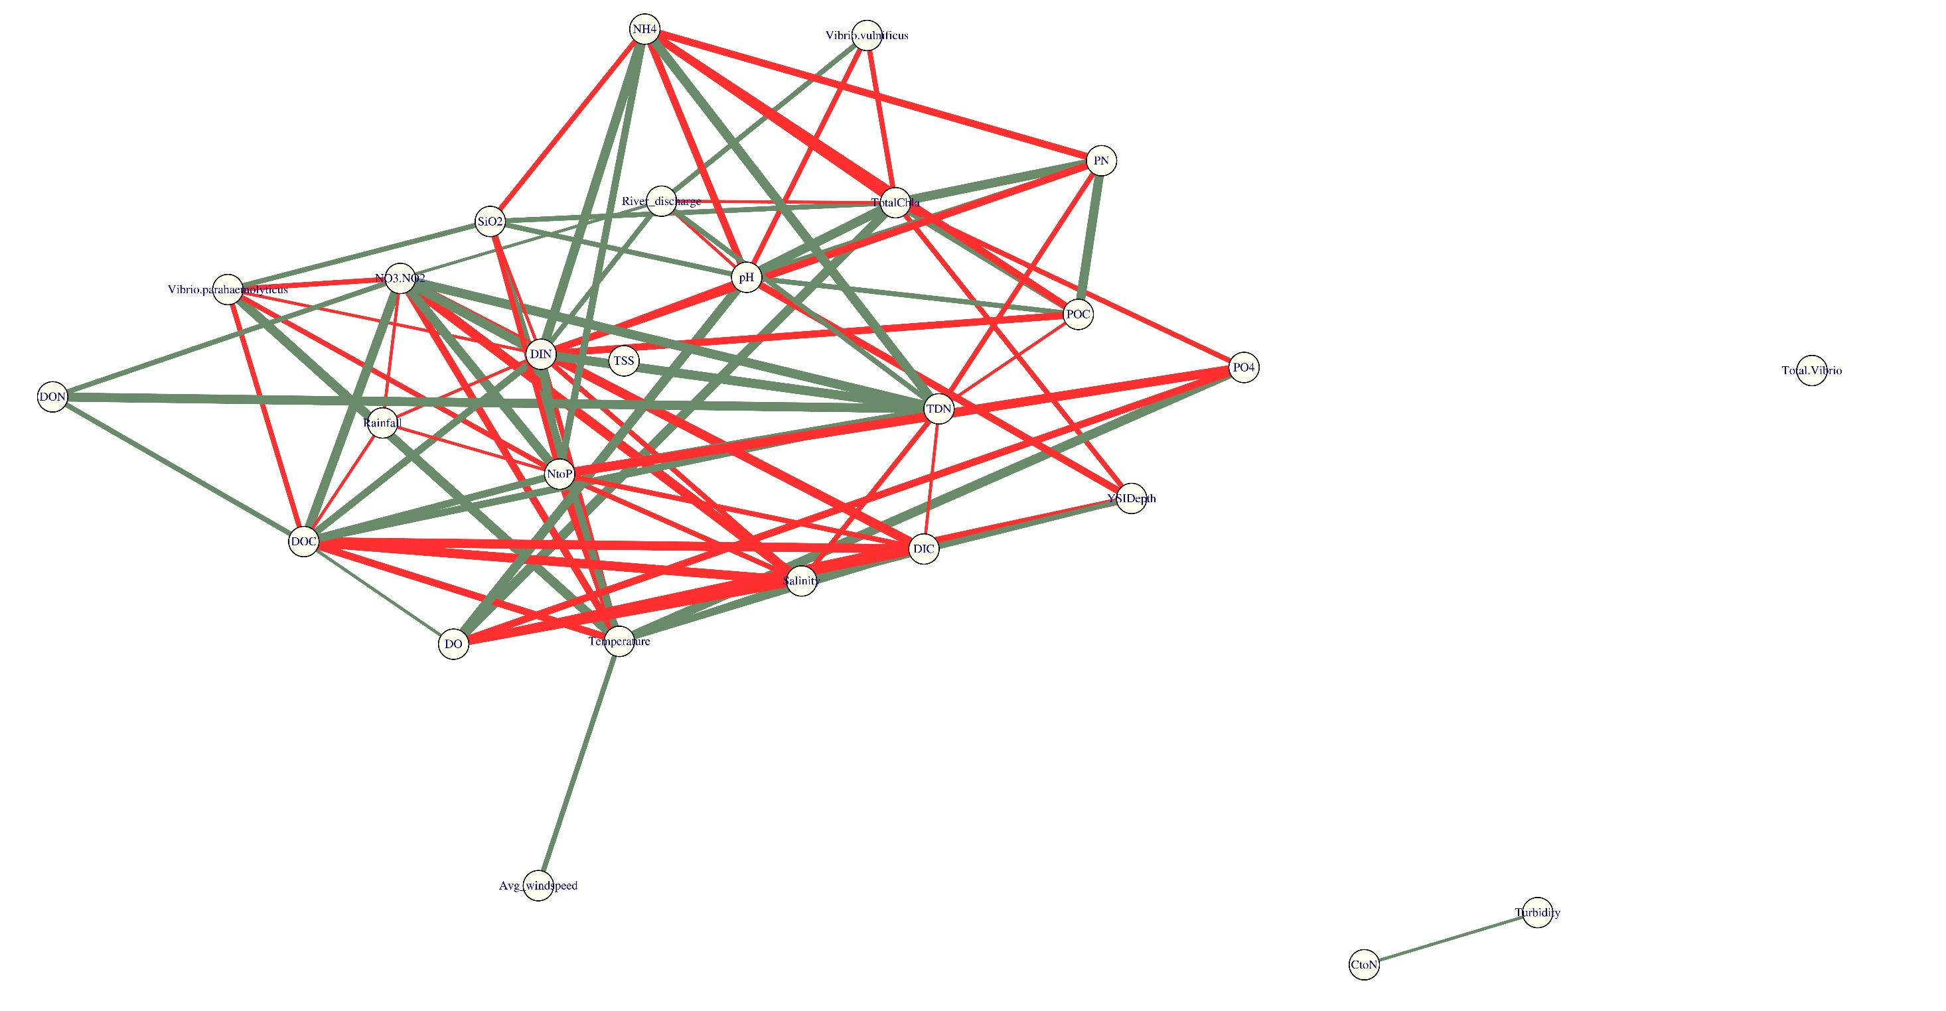

Slide 8
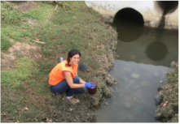
San Diego Vibrio sampling
Monthly Sampling: (Dec 2015-Nov 2016)
  Los Peñasquitos Lagoon
  San Diego River (2 sites)
  Tijuana River Estuary (2 sites)
Data available:
  Culture
  EnvironmentalChl. A (GF/F filters, 3 reps)
  Digital PCR
  Metagenomic
  16S and hsp60
Processing: Thanks to Rachel Diner and Andy Allen at JCVI/SIO
Notes:
Recent Vibrio cases prompted interest in Vp and Vv research-2 deaths

Slide 9
Salinity
Temperature
Salinity (PSU)
Temperature (°C)
Low salinities at LPL site are around the time of lagoon mouth closure
Low rainfall → higher summer salinities
Extremely warm temperatures
(El Niño year)
In the Vibrio proliferation range (>15ºC) at nearly all sites/times

Slide 10
ddPCR Results: tox R (V. parahaemolyticus)
From whole community DNA extractions
ddPCR on BioRad QX200 using positive control gene blocks and NTCs
Some very high copy number samples: Tijuana River Estuary

Slide 11
LPL
ddPCR Results: tox R (V. parahaemolyticus)
Some very high copy number samples @ Tijuana River Estuary sites (very high salinity: 30-40psu)
Correlation with temperature across sites?
22000
>
21000
TJ1
SDR1
toxR Copies/ 100 mL
toxR Copies/ 100 mL
34000
>
32000
TJ2
SDR2

Slide 12
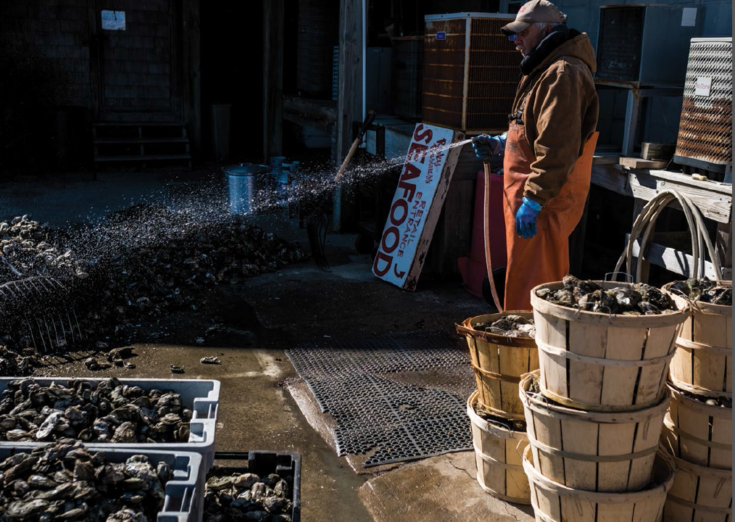
Discussion…

