Slide 1

2014 Vibriosis Update
Anna Newton, MPH
Epidemiologist
ISSC VMC Call
October 20, 2015
National Center for Emerging and Zoonotic Infectious Diseases
Division Foodborne, Waterborne, and Environmental Diseases

Slide 2
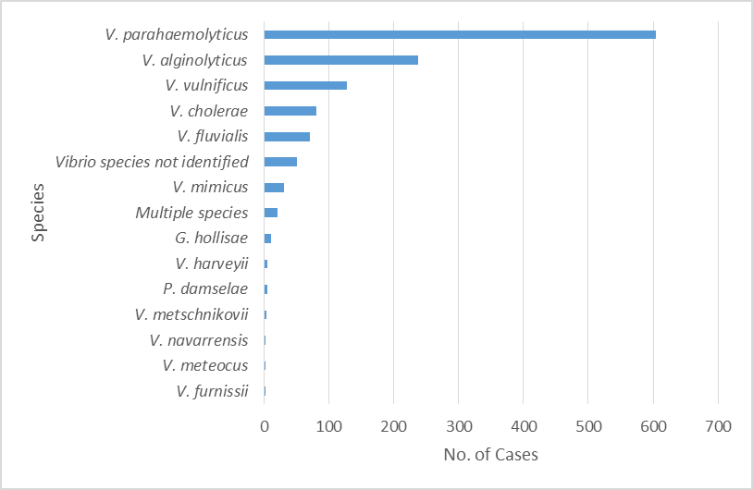
Vibriosis by species, 2014 (N=1,249)
Notes:
A total of 1,249 cases of Vibriosis were reported to COVIS in 2014. cases were reported from 48 states

Slide 3
Vibriosis by species, 2014 (N=1,249)

Slide 4
Vibriosis by species, 2014 (N=1,249)

Slide 5
Vibriosis by species, 2014 (N=1,249)

Slide 6
Selected demographics and clinical characteristics
 | V. parahaemolyticus n (%) | V. vulnificus n (%)
Male | 263 (65) | 102 (82)
Hospitalized | 72 (18) | 86 (78)
Died | 5 (1) | 22 (18)
*does not include 2014 CA data

Slide 7
Transmission route
 | V. parahaemolyticus n (%) | V. vulnificus n (%)
Foodborne | 327 (80) | 16 (13)
Non-foodborne | 68 (17) | 77 (62)
Unknown | 12 (3) | 31 (25)
Total | 407 | 124
*does not include 2014 CA data
Notes:
This table shows the same information presented in the graph on the previous slide

Slide 8
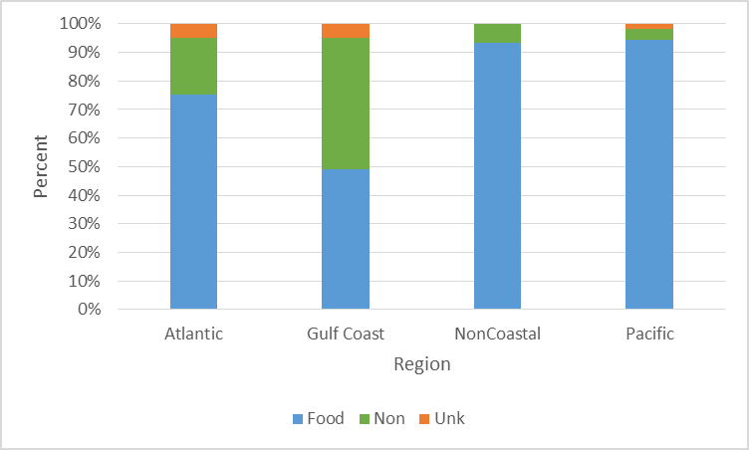
V. parahaemolyticus geographic distribution by transmission route (N=407)
*does not include 2014 CA data

Slide 9
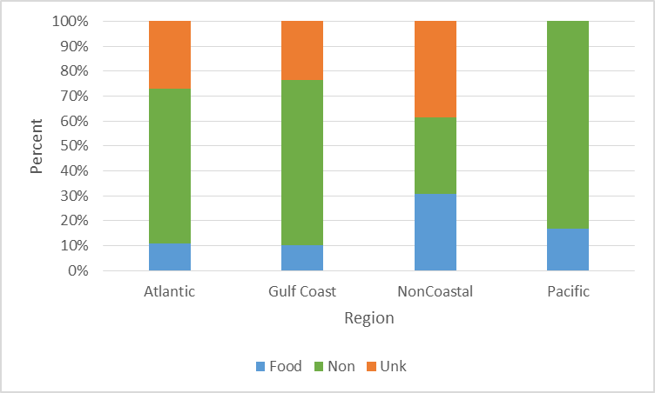
V. vulnificus geographic distribution by transmission route (N=124)
*does not include 2014 CA data

Slide 10
Foodborne transmission: shellfish consumed
 | V. parahaemolyticus n (%) | V. vulnificus n (%)
Any Seafood | 291 (89) | 15 (94)
Molluscan shellfish
Oysters | 226 (69) | 11 (73)
Clams | 59 (18) | 2 (13)
Mussels | 20 (6) | 0 (0)
*does not include 2014 CA data
**other seafood consumed includes: shrimp, crab, lobster, crawfish, squid, conch, scallops, and fish (catfish, bass, salmon, flounder, mahi mahi, runa)
Notes:
If we focus on those patients who had foodborne transmission, this table

Slide 11
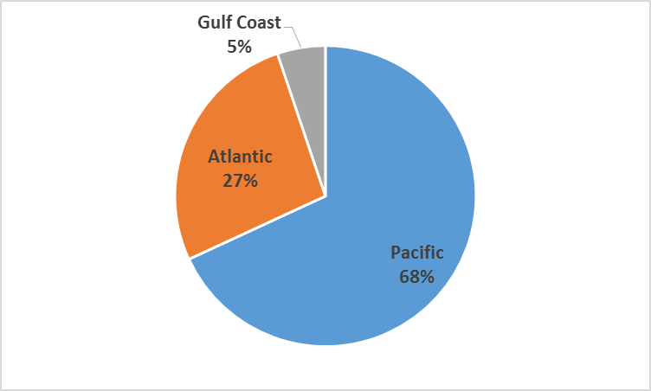
V. parahaemolyticus: shellfish harvest areas (n=116)

Slide 12
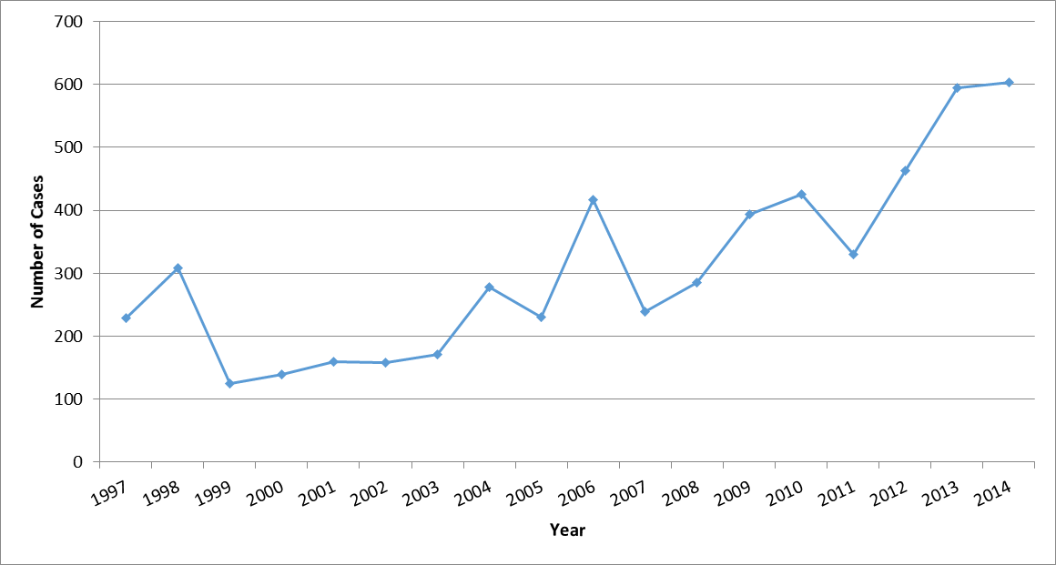
V. parahaemolyticus, United States, 1997-2014
Notes:
339 Vp infections were reported in 2014

Slide 13
V. parahaemolyticus by year and shellfish consumed**
Year | Reported oyster-associated Vp** | Reported clam-associated Vp** | Vp with seafood info available | Total Vp
1997 | 150 | 40 | 204 | 229
1998 | 164 | 39 | 243 | 308
1999 | 61 | 13 | 100 | 125
2000 | 65 | 19 | 119 | 140
2001 | 79 | 21 | 136 | 159
2002 | 66 | 31 | 132 | 158
2003 | 69 | 22 | 144 | 171
2004 | 159 | 40 | 244 | 278
2005 | 95 | 32 | 189 | 230
2006 | 242 | 63 | 374 | 417
2007 | 110 | 35 | 199 | 239
2008 | 143 | 31 | 241 | 285
2009 | 192 | 76 | 335 | 394
2010 | 209 | 70 | 342 | 425
2011 | 145 | 50 | 266 | 330
2012 | 225 | 78 | 377 | 463
2013 | 372 | 110 | 521 | 594
2014 | 228* | 61* | 307* | 604
TOTAL | 2,774 | 831 | 4,473 | 5,549
*not including 2014 CA data
**patients may have consumed more than one type of seafood

Slide 14
V. parahaemolyticus by year and shellfish consumed**
Year | Reported oyster-associated Vp** | Reported clam-associated Vp** | Vp with seafood info available | Total Vp
1997 | 150 | 40 | 204 | 229
1998 | 164 | 39 | 243 | 308
1999 | 61 | 13 | 100 | 125
2000 | 65 | 19 | 119 | 140
2001 | 79 | 21 | 136 | 159
2002 | 66 | 31 | 132 | 158
2003 | 69 | 22 | 144 | 171
2004 | 159 | 40 | 244 | 278
2005 | 95 | 32 | 189 | 230
2006 | 242 | 63 | 374 | 417
2007 | 110 | 35 | 199 | 239
2008 | 143 | 31 | 241 | 285
2009 | 192 | 76 | 335 | 394
2010 | 209 | 70 | 342 | 425
2011 | 145 | 50 | 266 | 330
2012 | 225 | 78 | 377 | 463
2013 | 372 | 110 | 521 | 594
2014 | 228* | 61* | 307* | 604
TOTAL | 2,774 | 831 | 4,473 | 5,549
*not including 2014 CA data
**patients may have consumed more than one type of seafood

Slide 15
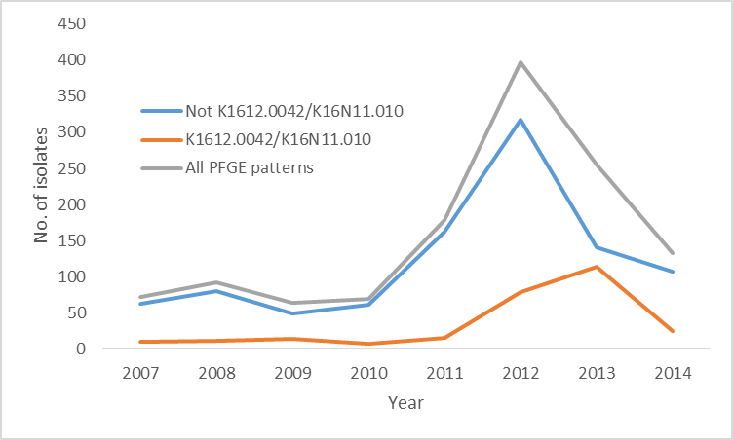
V. parahaemolyticus PFGE, 2007-2014
2014 data preliminary

Slide 16
Questions?
For more information please contact Centers for Disease Control and Prevention
1600 Clifton Road NE, Atlanta, GA 30333
Telephone: 1-800-CDC-INFO (232-4636)/TTY: 1-888-232-6348
Visit: www.cdc.gov | Contact CDC at: 1-800-CDC-INFO or www.cdc.gov/info
The findings and conclusions in this report are those of the authors and do not necessarily represent the official position of the Centers for Disease Control and Prevention.
National Center for Emerging and Zoonotic Infectious Diseases
Division of Foodborne, Waterborne, and Environmental Diseases

